Slide 1
Integrated Assessment of Environmental Footprints of Energy Pathways
NSERC/Cenovus/Alberta Innovates Associate Industrial Chair Program in Energy and Environmental Systems Engineering
www.energysystems.ualberta.ca
Webinar
March 3, 2020
Thomas Patrick, Matthew Davis, Eskinder Gemechu, Amit Kumar
Department of Mechanical Engineering, University of Alberta, Edmonton, Canada

Slide 2
Overall Structure of the NSERC Industrial Research Chair Program

Slide 3
LEAP/WEAP GROUP
Group members:
  Eskinder Gemechu, PDF
  Matthew Davis, Research Engineer
  Saeidreza Radpour, PhD student
  Christophe Owttrim, MSc student
  Thomas Patrick, MSc student
  Minza Haider, MSc student
  Ayodeji Okunlola, PhD student
Past HQPs: 18
  PDF: 2
  PhD: 2
  MSc: 10
  RA/Undergrads/Interns: 4

Slide 4
OUTLINE
Modelling approach
The WEAP-Canada model
Summary of research on integrated assessments
Questions – Please type your question in the chat box or just indicate that you have a question to ask
Long-range Energy Alternative Planning (LEAP) Model integration with WEAP
Water Evaluation and Planning (WEAP) Model
Life cycle water footprints

Slide 5
GENERALIZED MODELLING APPROACH
Process Modelling
Environmental Assessment/
Cost Estimation
Energy/Water Modelling
Outputs
Technology characterization
e.g. Renewable-based power generation
Environmental Modelling
(Life Cycle Assessment)
g CO₂ eq per unit output
m³ water per unit output
Water modelling
(WEAP - Water Evaluation And Planning)
Canada-wide
Water demand
Water supply
Long-term annual results per scenario
Total water withdrawal
Total water consumption
Total water savings
Specification of unit operations for each alternative pathways
Economic Modelling
(Techno-Economic Assessment)
Cost metrics
$ per unit output
Energy modelling
(LEAP - Long-range Energy Alternatives Planning)
Canada-wide
Energy demand
Energy supply
Long-term annual results per scenario
Energy demand
Technology use
GHG emissions
System costs
$/tonne of CO₂ abatement
$/liter of water saved
Characterization process equipment for unit operations
Determination of energy/resource inputs for each process equipment

Slide 6
GENERALIZED MODELLING APPROACH
Process Modelling
Environmental Assessment/
Cost Estimation
Energy/Water Modelling
Outputs
Technology characterization
e.g. Renewable-based power generation
Environmental Modelling
(Life Cycle Assessment)
g CO₂ eq per unit output
m³ water per unit output
Water modelling
(WEAP - Water Evaluation And Planning)
Canada-wide
Water demand
Water supply
Long-term annual results per scenario
Total water withdrawal
Total water consumption
Total water savings
Specification of unit operations for each alternative pathways
Economic Modelling
(Techno-Economic Assessment)
Cost metrics
$ per unit output
Energy modelling
(LEAP - Long-range Energy Alternatives Planning)
Canada-wide
Energy demand
Energy supply
Long-term annual results per scenario
Energy demand
Technology use
GHG emissions
System costs
$/tonne of CO₂ abatement
$/liter of water saved
Characterization process equipment for unit operations
Determination of energy/resource inputs for each process equipment

Slide 7
LIFE CYCLE WATER FOOTPRINTS

Slide 8
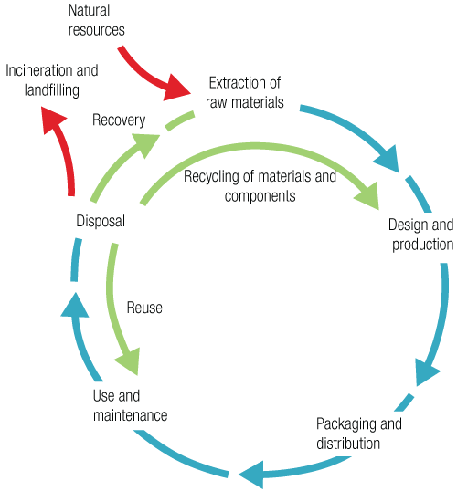
LIFE CYCLE ASSESSMENT – WATER FOOTPRINTS
System approach and based on life cycle thinking
Goal and Scope Definition
Interpretation
Life Cycle Inventory Analysis
Life Cycle Impact Assessment
Source: Life Cycle Initiative (http://www.lifecycleinitiative.org)
Life cycle assessment framework according to ISO

Slide 9
WATER-DEMAND COEFFICIENT – DEFINITIONS
Water footprint: The total volume of freshwater used in the life cycle of a product system – L/kWh, L/tonne, L/bbl
Water withdrawal: The total volume of water removed from a water source
Water consumed: The amount of water removed for use but not returned to its source (includes evaporation, transpiration and direct consumption)
Water returned: The amount of water sent back to the source (effluent)

Slide 10
WATER-DEMAND COEFFICIENT FRAMEWORK
Coal-based power generation technologies
Gas-fired power generation technologies
Power generation from renewable energy technologies
Crude oil production
Oil sands-based transportation fuel
Others

Slide 11
WATER FOOTPRINTS FOR CRUDE OIL PRODUCTION, UPGRADING, AND REFINING
Ali and Kumar (2017), Energy, vol. 131, pp. 41-49, 2017.
Water footprint for 4 major pathways were developed

Slide 12
WATER FOOTPRINTS FOR RENEWABLE POWER GENERATION TECHNOLOGIES
Ali and Kumar (2017), Energy Conversion and Management, vol. 143, pp. 470-481, 2017.
Water footprint for 60 renewable energy based power generation pathways were developed

Slide 13
WATER FOOTPRINTS FOR GAS-FIRED POWER GENERATION TECHNOLOGIES
Gas sources
Gas processes
Gas delivery
Power plant technology
Cooling system
Conventional gas
Exploration
Pipeline
Single cycle
Once-through cooling
Storage
Drilling
Combined cycle (NGCC)
Coal-bed methane (CBM)
Distribution
Fracturing
Cooling tower
Steam cycle
Water produced
Cooling pond
Shale gas
Well abandonment
Cogeneration
Dry cooling
Other
Ali and Kumar (2016), Energy Conversion and Management, vol. 110, pp. 386-396.
Water-demand coefficients were developed for 18 generic pathways

Slide 14
WATER FOOTPRINTS FOR COAL-BASED POWER GENERATION TECHNOLOGIES
Coal mining
Coal preparation
Coal transportation
Power plant technology
Cooling system
Other operation
Surface mining without revegetation
Crushing
Truck
Subcritical
Once-through cooling
Ash handling
Rail
Supercritical
Washing
Drinking
Surface mining with revegetation
Barge
Cooling tower
Ultra-supercritical
Dust suppression
Conveyor
Cooling pond
Underground mining
Slurry pipeline
Desulphurization
Integrated combined cycle (IGCC)
Dry cooling
Coal log pipeline
Plant decommissioning
Ali and Kumar (2015), Energy Conversion and Management, vol. 90, pp. 247-260
Water-demand coefficients for 36 different electricity generation pathways

Slide 15
GENERALIZED MODELLING APPROACH
Process Modelling
Environmental Assessment/
Cost Estimation
Energy/Water Modelling
Outputs
Technology characterization
e.g. Renewable-based power generation
Environmental Modelling
(Life Cycle Assessment)
g CO₂ eq per unit output
m³ water per unit output
Water modelling
(WEAP - Water Evaluation And Planning)
Canada-wide
Water demand
Water supply
Long-term annual results per scenario
Total water withdrawal
Total water consumption
Total water savings
Specification of unit operations for each alternative pathways
Economic Modelling
(Techno-Economic Assessment)
Cost metrics
$ per unit output
Energy modelling
(LEAP - Long-range Energy Alternatives Planning)
Canada-wide
Energy demand
Energy supply
Long-term annual results per scenario
Energy demand
Technology use
GHG emissions
System costs
$/tonne of CO₂ abatement
$/liter of water saved
Characterization process equipment for unit operations
Determination of energy/resource inputs for each process equipment

Slide 16
WATER EVALUATION AND PLANNING (WEAP)

Slide 17
BACKGROUND
& WEAP CHARACTERISTICS
Background
  A modelling framework is required to implement our understanding of a complex system
  WEAP is developed by the Stockholm Environmental Institute, with support from US Army Corps of Engineers, the World Bank, and many others
  Used by a variety of academic and other groups internationally, such as the UN Department of Economic and Social Affairs
Key characteristics of WEAP
  Simple to understand and use
  Wide ranging features available but optional
  Built in compatibility with Long-range Energy Alternatives Planning (LEAP) model for energy modelling

Slide 18

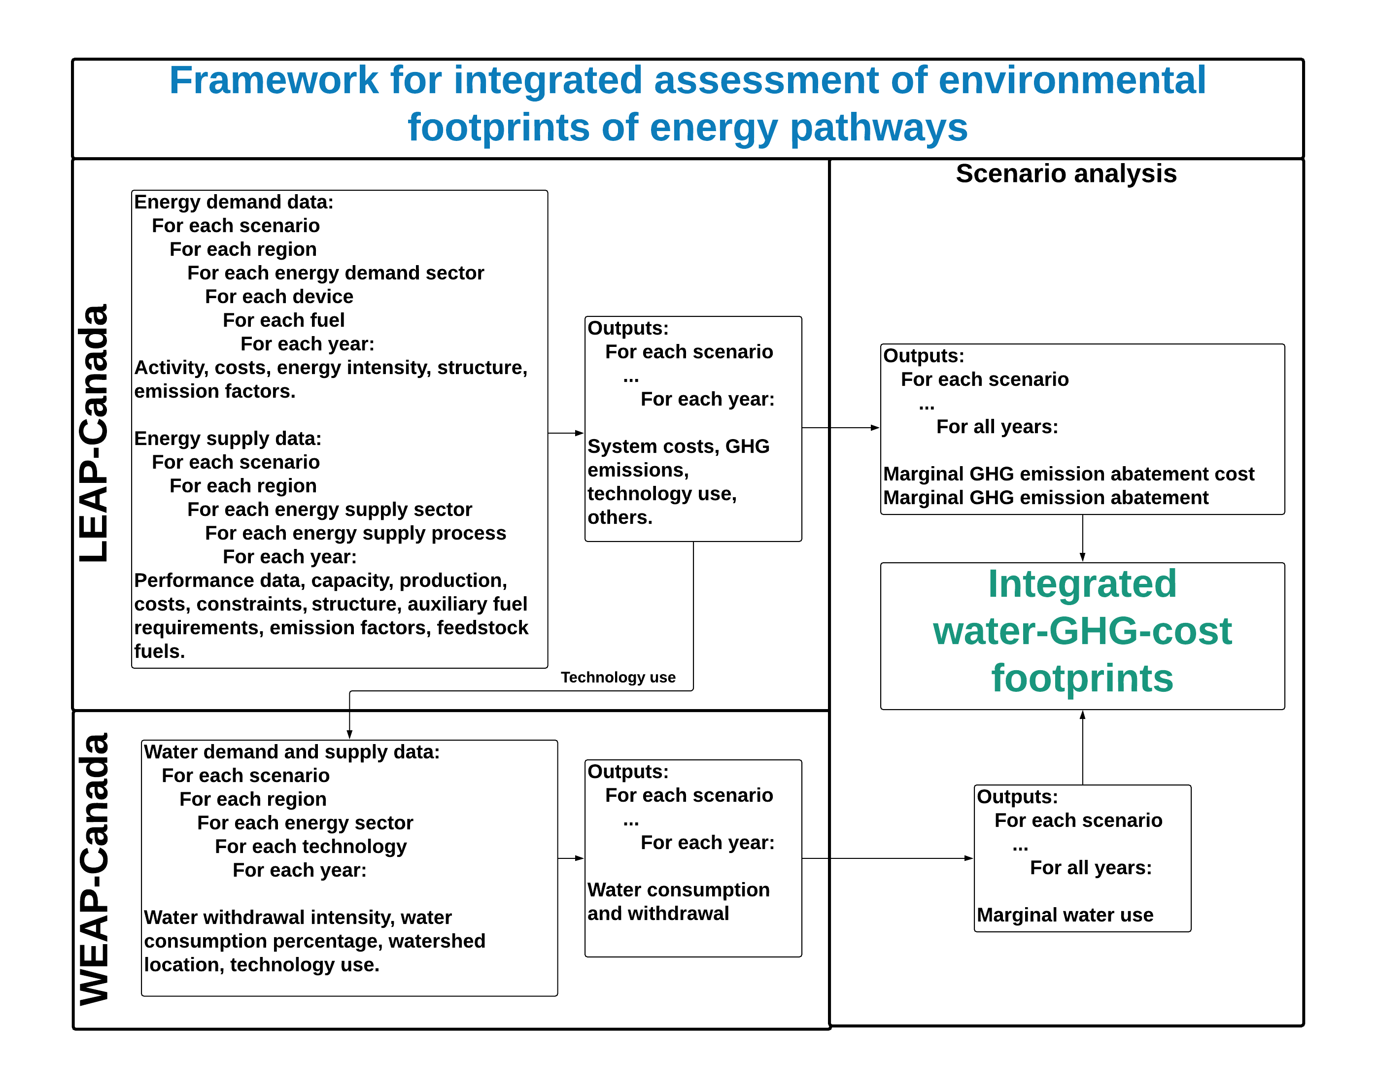
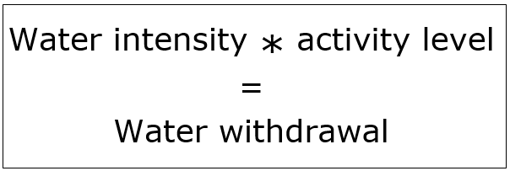
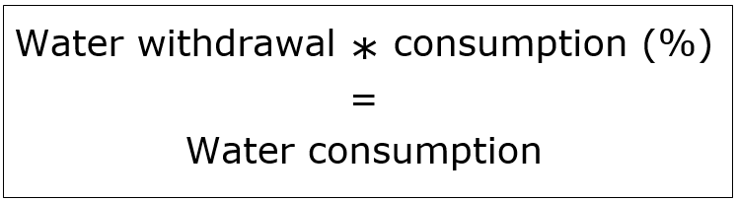
WEAP FRAMEWORK

Slide 19
WEAP-CANADA MAIN ELEMENTS
Sample model creation:
Water use of bitumen mining

Slide 20
WEAP-CANADA MAIN ELEMENTS
(OIL AND GAS SECTOR)
Graphical user interface (GUI)
Geographical information system (GIS)
Water supply sources
Water demand sites
Demand site activity
Water-use intensities
Optimization
Scenario analysis
WEAP

Slide 21
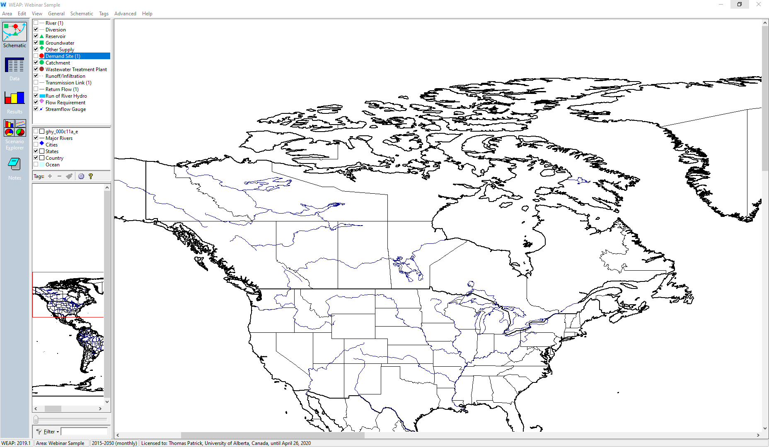

Slide 22
WEAP-CANADA MAIN ELEMENTS
(OIL AND GAS SECTOR)
Graphical user interface (GUI)
Geographical information system (GIS)
Water supply sources
Water demand sites
Demand site activity
Water-use intensities
Optimization
Scenario analysis
WEAP

Slide 23
Athabasca River not included in base
model geography

Slide 24
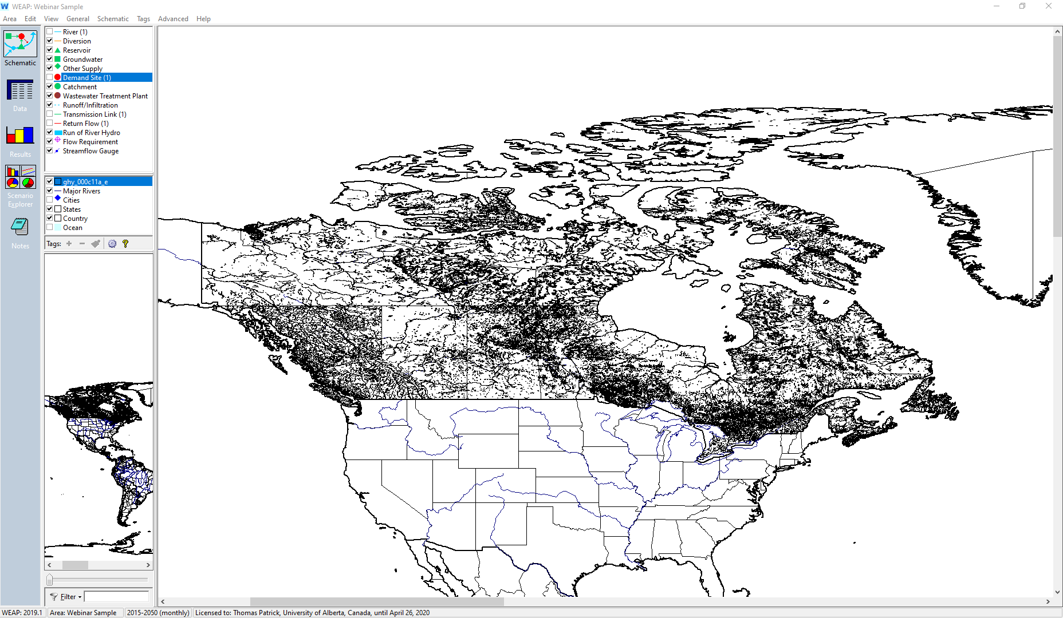
Vector layer added showing
Canada’s water features

Slide 25
WEAP-CANADA MAIN ELEMENTS
(OIL AND GAS SECTOR)
Graphical user interface (GUI)
Geographical information system (GIS)
Water supply sources
Water demand sites
Demand site activity
Water-use intensities
Optimization
Scenario analysis
WEAP

Slide 26
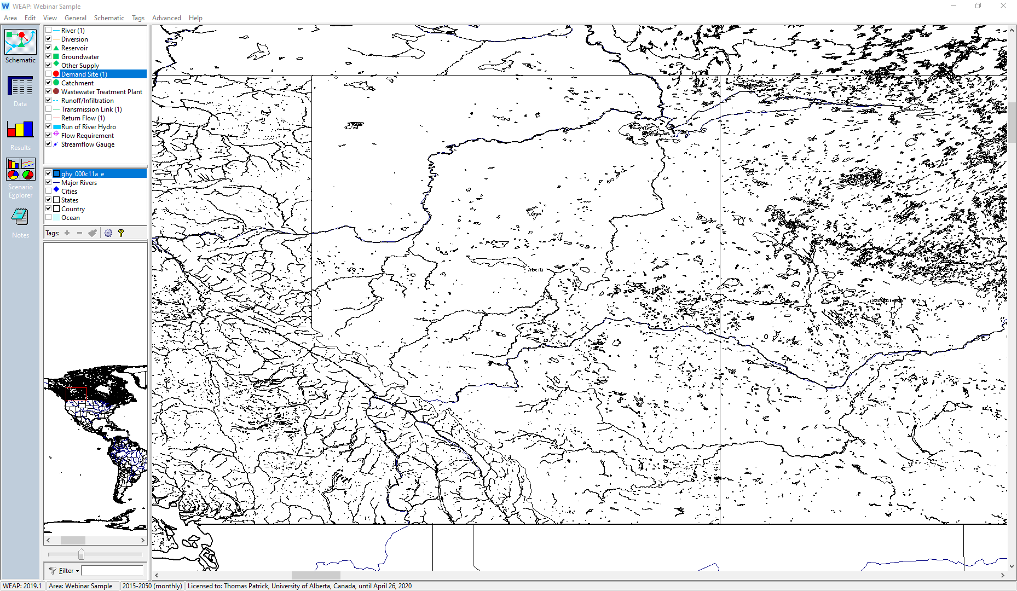

Slide 27
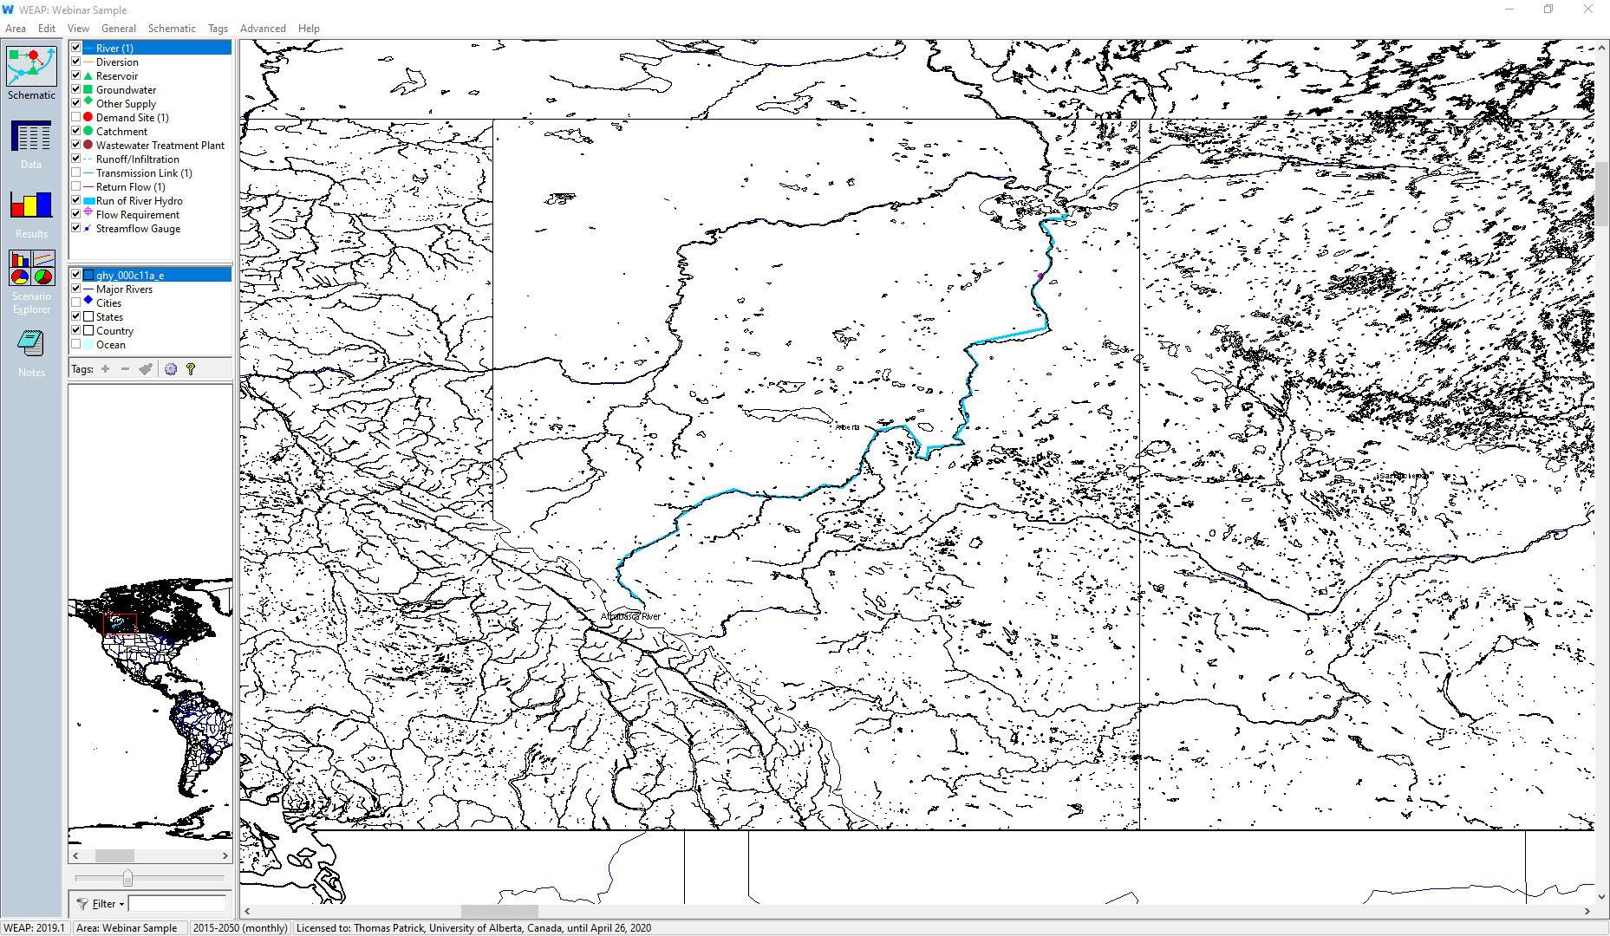
The light blue line
is the river feature

Slide 28
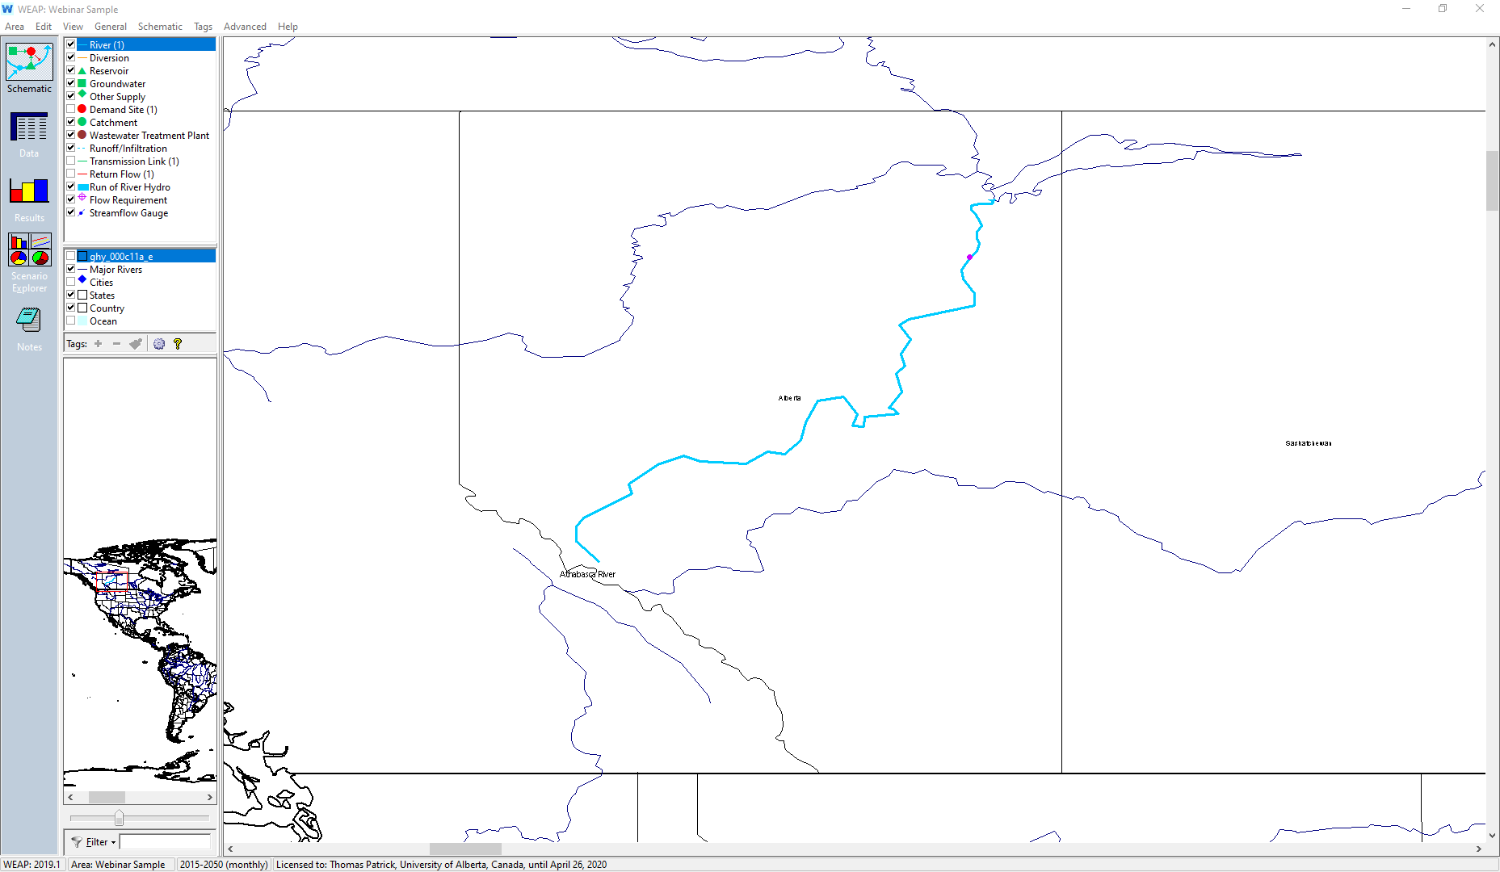
The light blue line
is the river feature

Slide 29
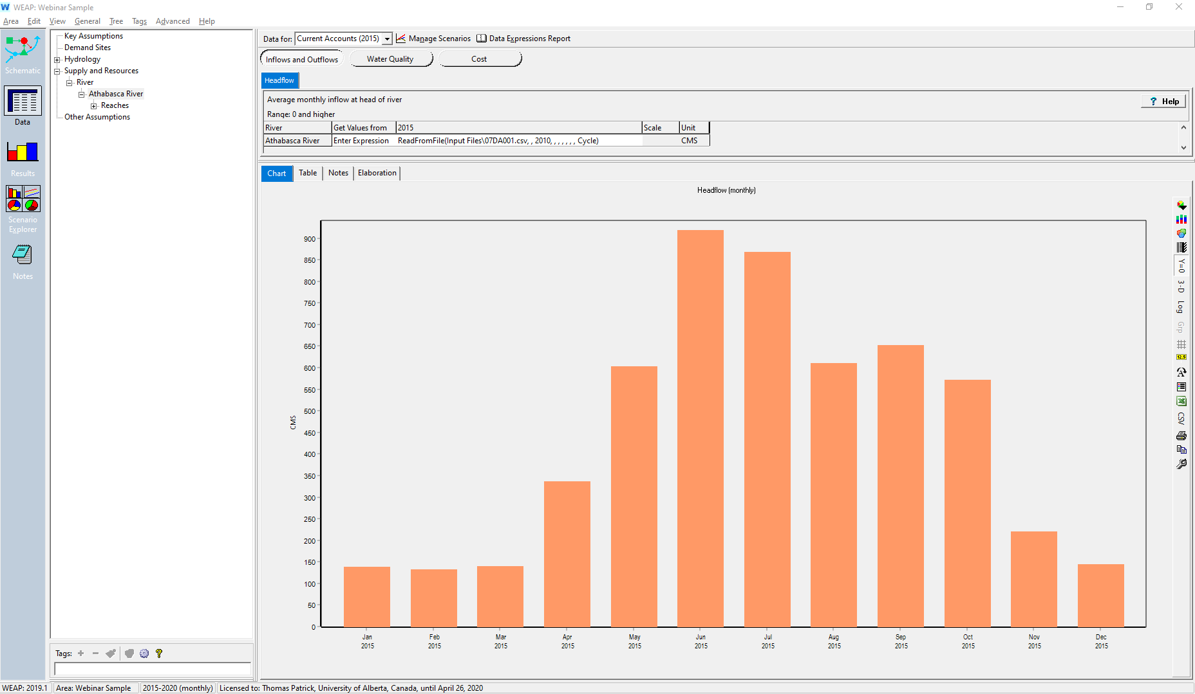
Scenario selected: Current Accounts (2015)
Headflow (monthly)
Item selected: Athabasca River
Panel on right: shows data for this river
Jan
2015
Dec
2015

Slide 30
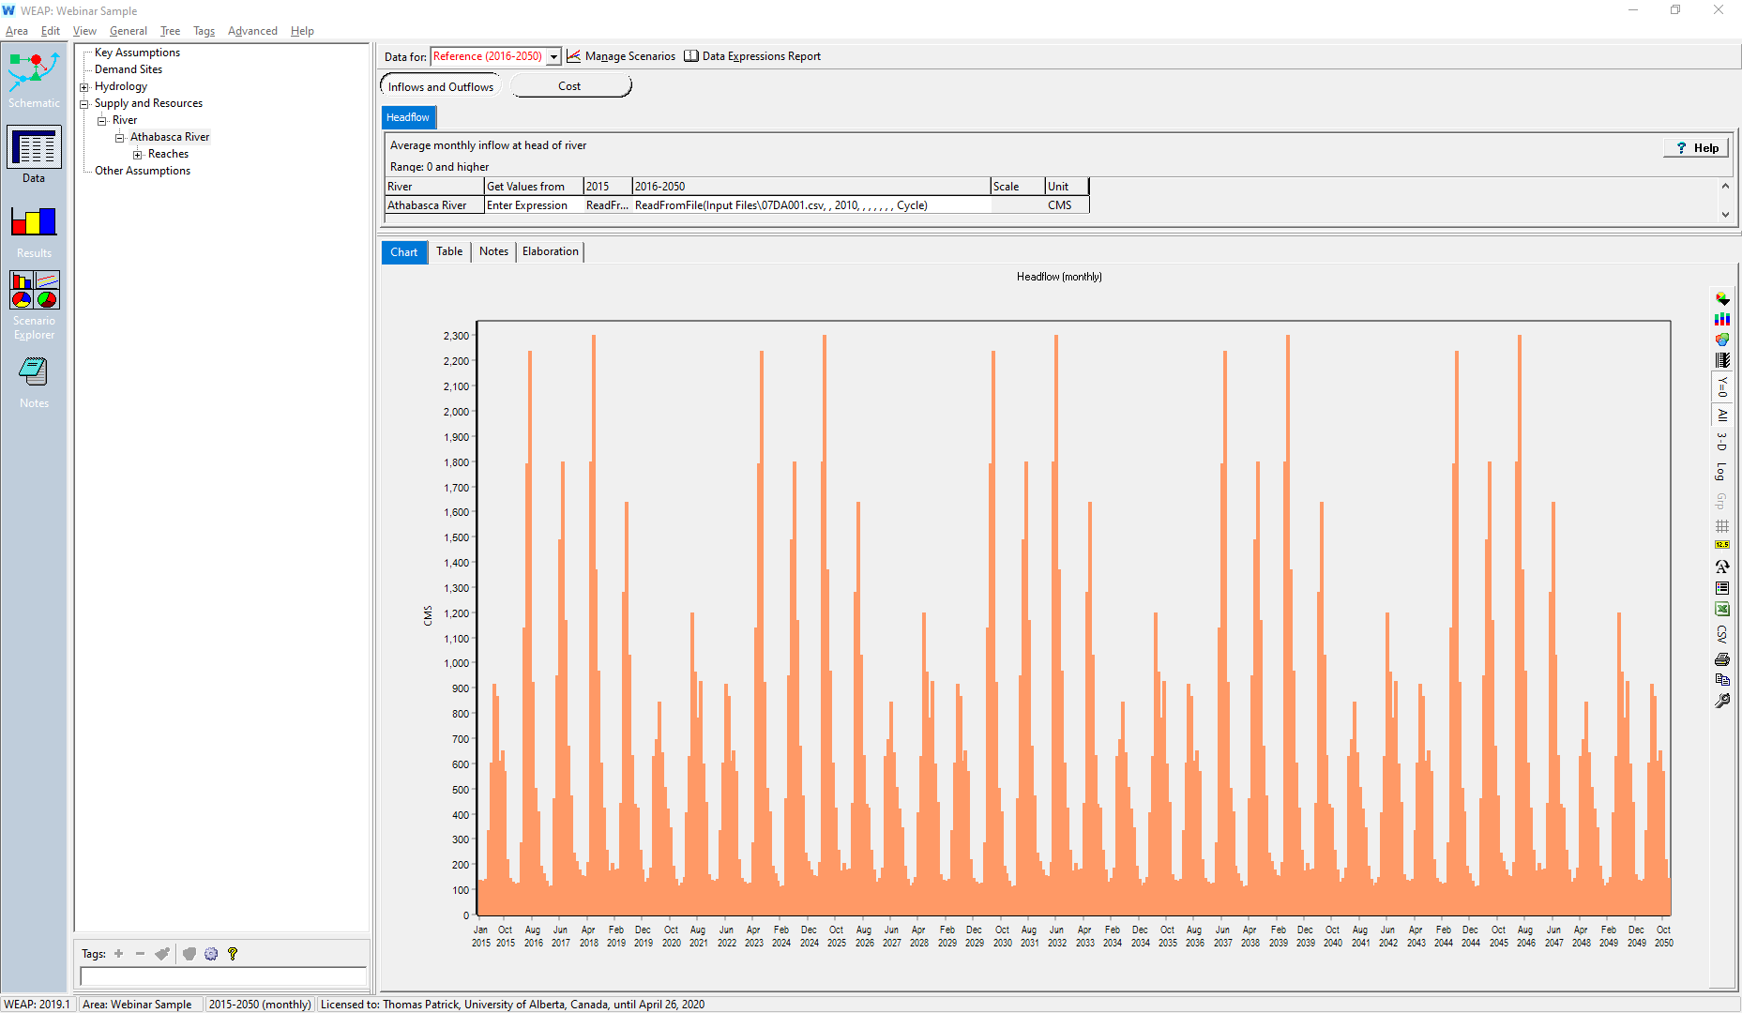
Scenario selected: Reference (2016-2050)
Headflow (monthly)
Item selected: Athabasca River
Panel on right: shows data for this river
Jan
2015
Dec
2050

Slide 31
WEAP-CANADA MAIN ELEMENTS
(OIL AND GAS SECTOR)
Graphical user interface (GUI)
Geographical information system (GIS)
Water supply sources
Water demand sites
Demand site activity
Water-use intensities
Optimization
Scenario analysis
WEAP

Slide 32
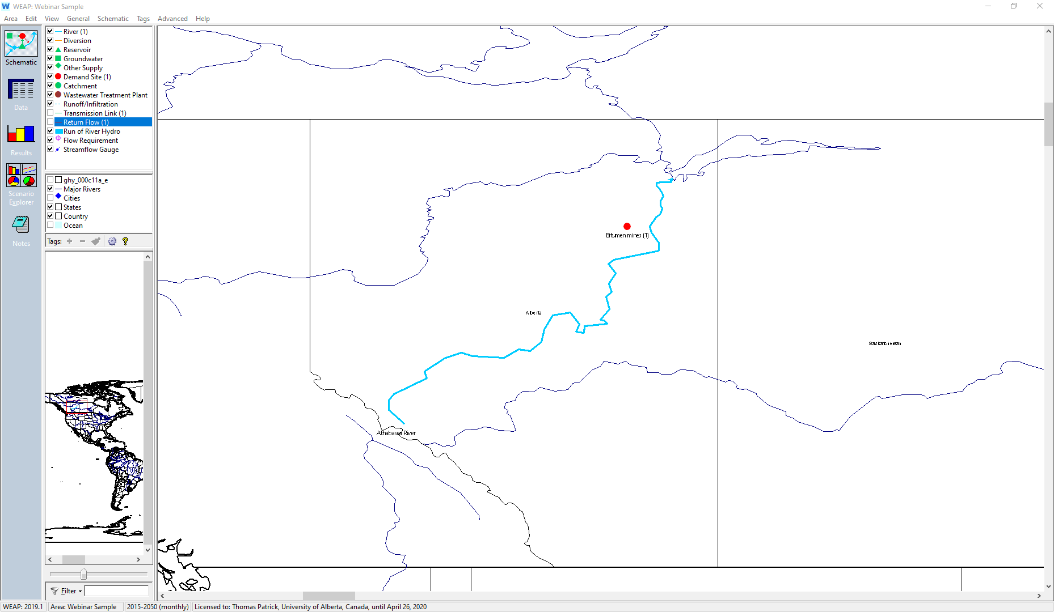
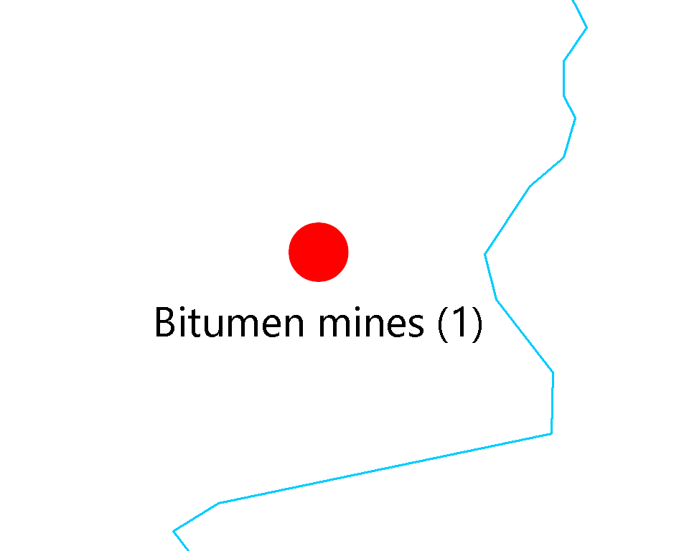

Slide 33

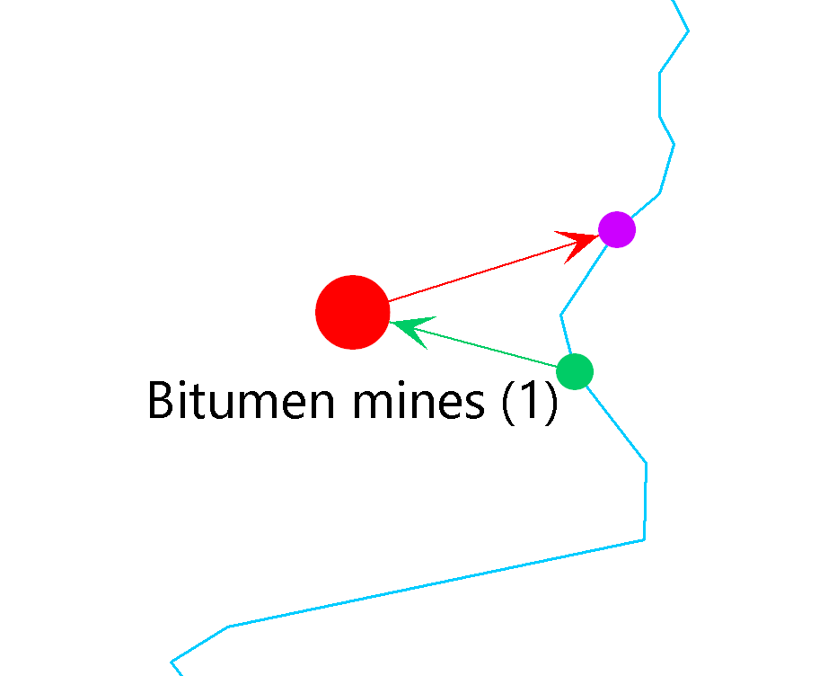

Slide 34
WEAP-CANADA MAIN ELEMENTS
(OIL AND GAS SECTOR)
Graphical user interface (GUI)
Geographical information system (GIS)
Water supply sources
Water demand sites
Demand site activity
Water-use intensities
Optimization
Scenario analysis
WEAP

Slide 35
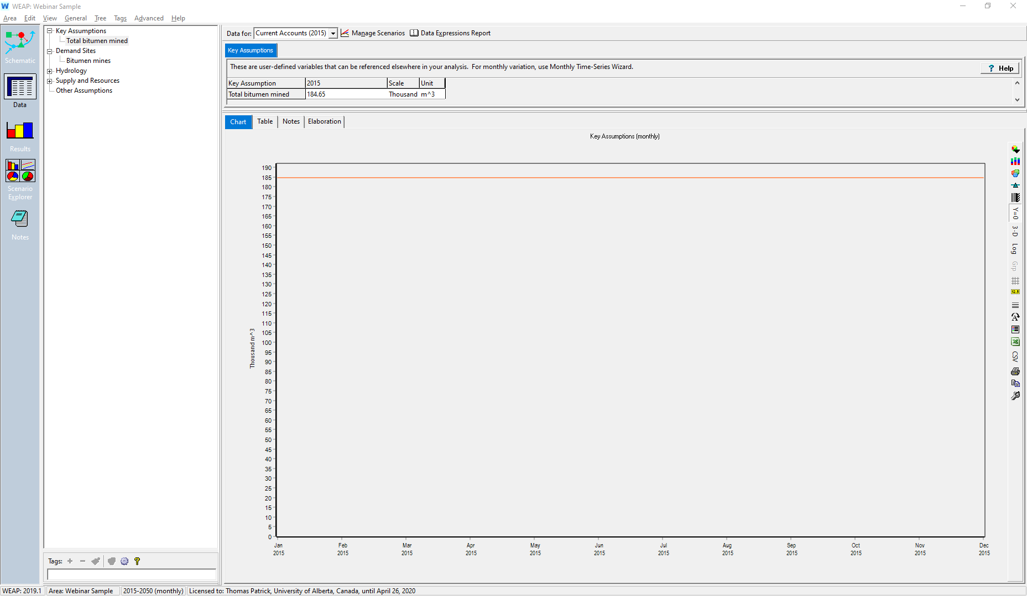
Scenario selected: Current Accounts (2015)
Input value: 184.65 thousand m³/d
(historic data)
Item selected:
Total bitumen mined

Slide 36
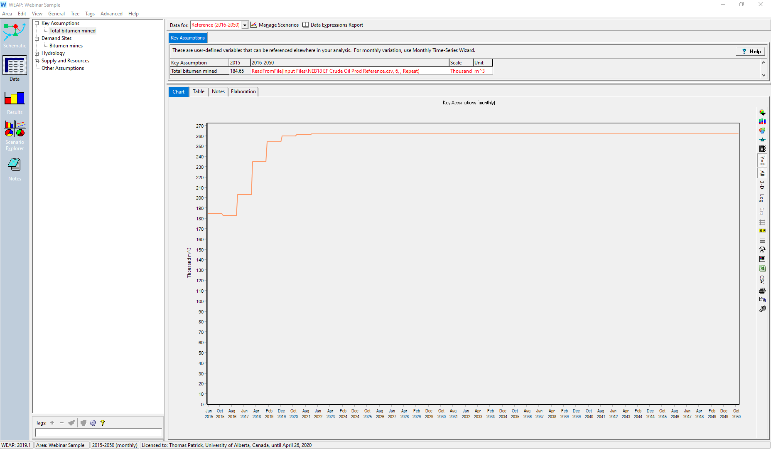
Scenario selected: Reference (2016-2050)
Item selected:
Total bitumen mined
CER mined bitumen projection to 2040,
then extrapolated to 2050
2015: ~185 thousand m³/d (1.16 Mb/d)
2050: ~260 thousand m³/d (1.65 Mb/d)

Slide 37
WEAP-CANADA MAIN ELEMENTS
(OIL AND GAS SECTOR)
Graphical user interface (GUI)
Geographical information system (GIS)
Water supply sources
Water demand sites
Demand site activity
Water-use intensities
Optimization
Scenario analysis
WEAP

Slide 38
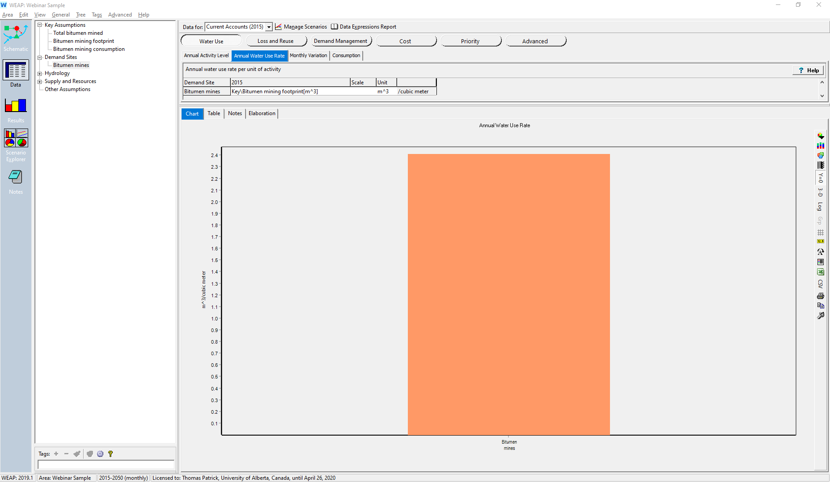
New quantities defined for:
Bitumen mining footprint
Bitumen mining consumption
Footprint: 2.41 m³ water/m³ bitumen
From AER water use report
Consumption: 82%
From literature

Slide 39
WEAP-CANADA MAIN ELEMENTS
(OIL AND GAS SECTOR)
Graphical user interface (GUI)
Geographical information system (GIS)
Water supply sources
Water demand sites
Demand site activity
Water-use intensities
Optimization
Scenario analysis
WEAP

Slide 40
WEAP-CANADA MAIN ELEMENTS -
OPTIMIZATION
WEAP calculates water behaviour with a linear program
  Optimizes demand site coverage and any instream flow requirements
  Contingent on demand priorities, supply preferences, etc.
Optimization of cost / technology choices done in LEAP

Slide 41
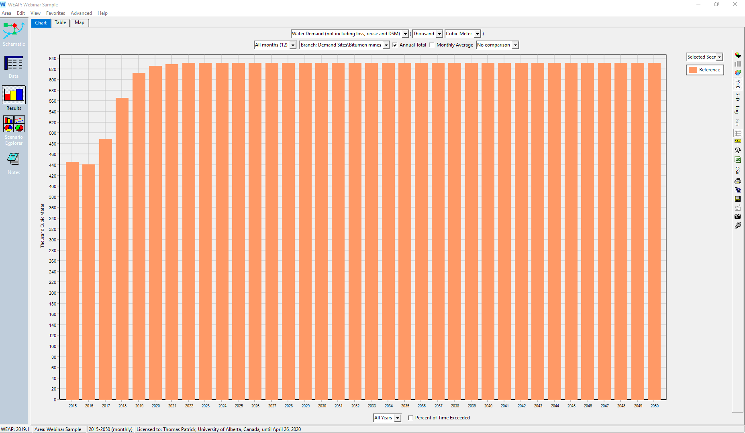
Model parameters:
This model contains one demand site: bitumen mining
Activity level: CER projection
Water footprint: assumes 2015 value over entire model duration

Slide 42
WEAP-CANADA MAIN ELEMENTS
(OIL AND GAS SECTOR)
Graphical user interface (GUI)
Geographical information system (GIS)
Water supply sources
Water demand sites
Demand site activity
Water-use intensities
Optimization
Scenario analysis
WEAP

Slide 43
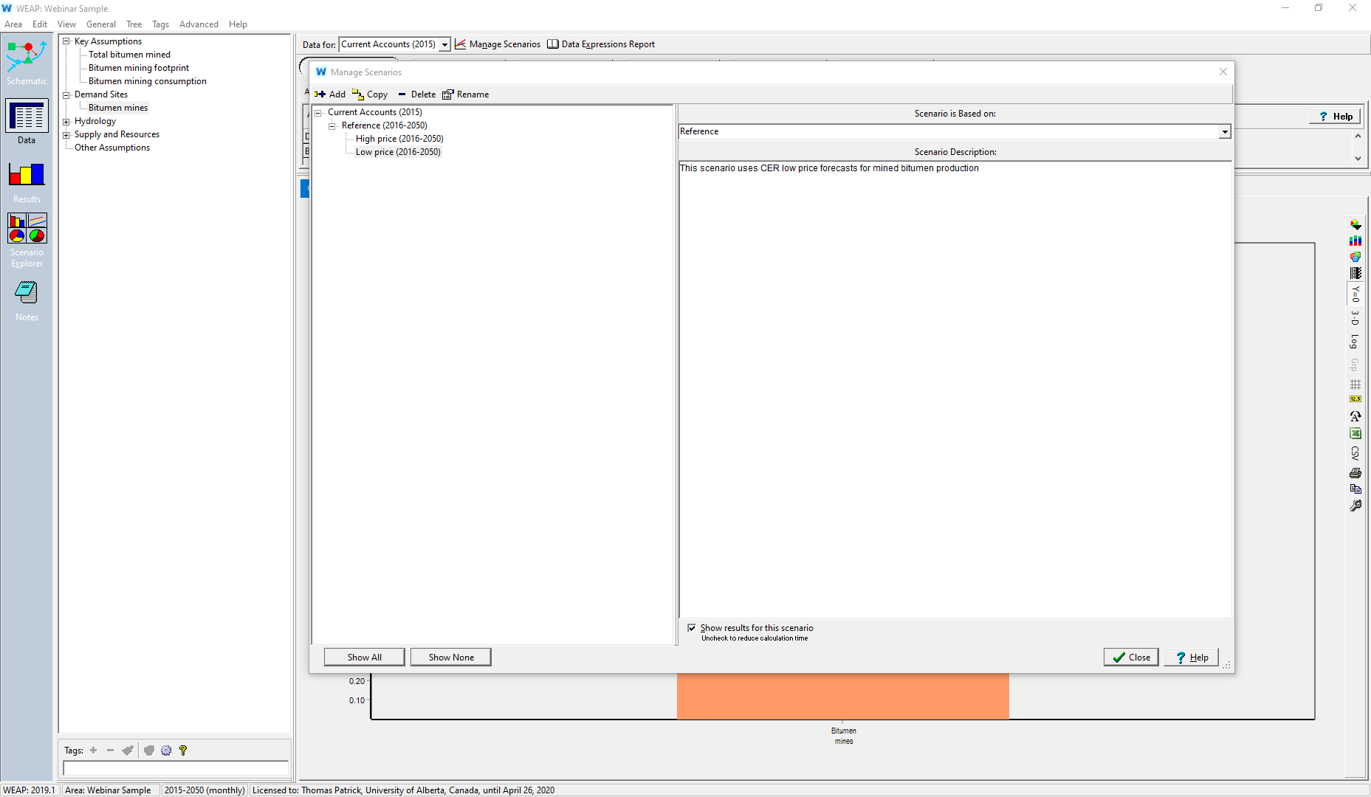

High and low price scenarios will be based on CER high and low
price projections for volume of bitumen production

Slide 44
WEAP-CANADA
OIL AND GAS PRICE SCENARIOS
CER oil production forecast based on long term oil price
Reference scenario forecast: ≈$60/barrel WCS
Low price: ≈$20/barrel WCS
High price: ≈$100/barrel WCS

Slide 45
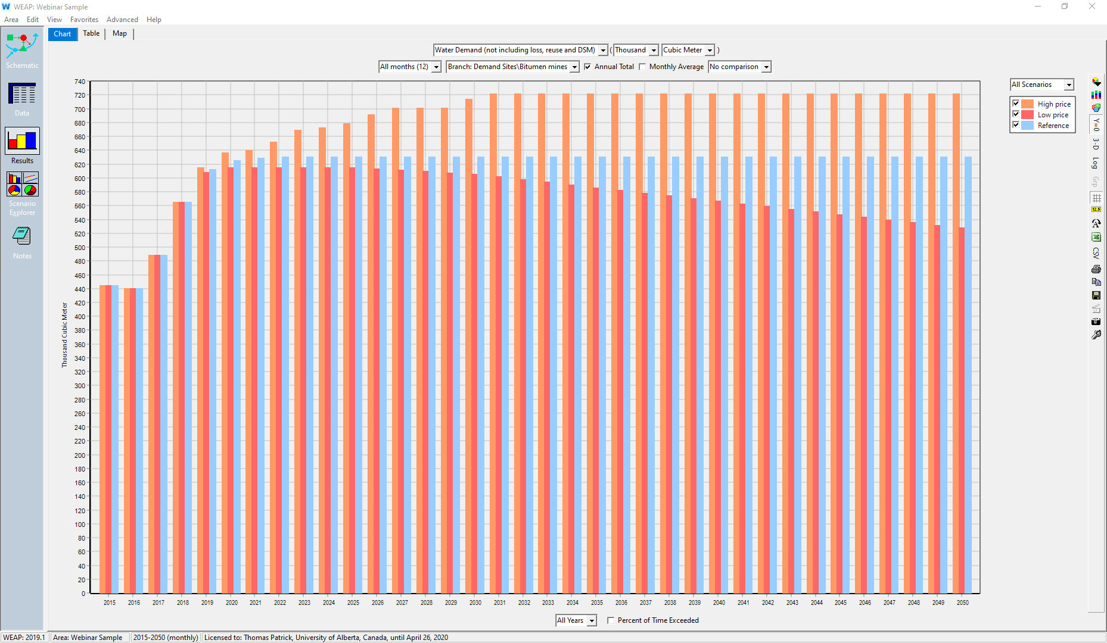
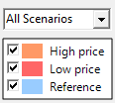
Total water demand in model
High price scenario
Reference scenario
Low price scenario

Slide 46
WEAP-CANADA OIL AND GAS
Actual model

Slide 47
WEAP-CANADA OIL AND GAS
Subsectors included in model
  Conventional oil
  Natural gas – well creation
  Bitumen – surface mines
  Bitumen – in situ
  Upgrading
  Refining

Slide 48
WEAP-CANADA OIL AND GAS
FRAMEWORK
River basin
Sub-sector (demand node)
River basin “A”
Technology/site distinctions
Bitumen mining
Bitumen TIS
Conventional oil
Natural gas
Refining
Upgrading
Mine 1
Mine 2
[...]
CSS
SADG
Primary
Drilling
Fracturing

Slide 49
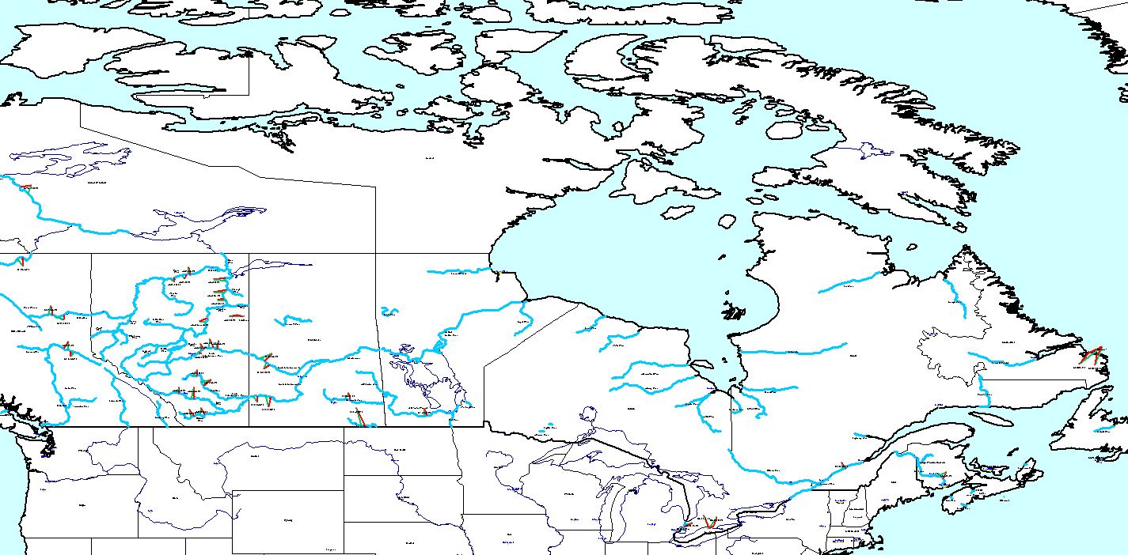
WEAP-CANADA OIL AND GAS
SCHEMATIC
6 subsectors
38 demand sites
19 river basins
Covers all provinces
2005-2050

Slide 50
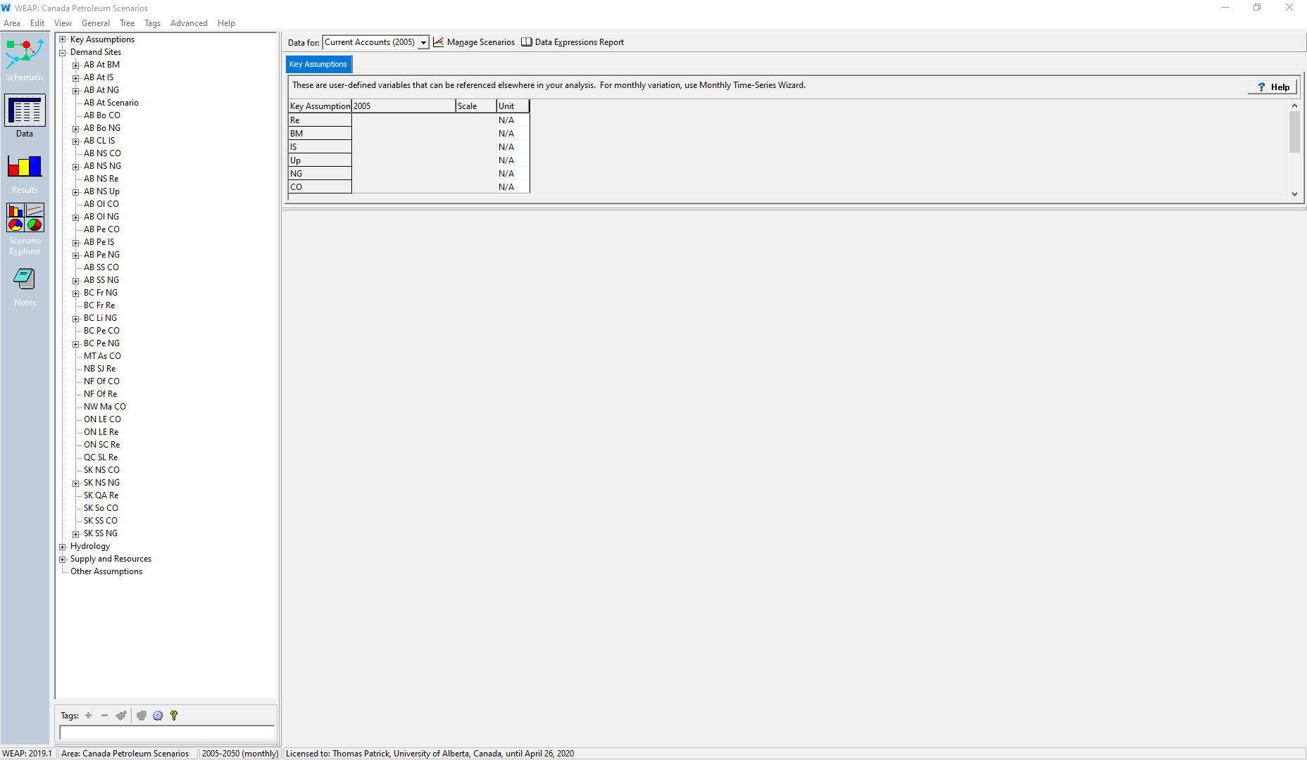
WEAP-Canada Oil and Gas demand sites
Alberta: many o&g sites, all subsectors
6 subsectors
38 demand sites
19 river basins
Covers all provinces
2005-2050
BC: natural gas, oil, and refining
Manitoba: some conventional oil
Atlantic: refining, offshore oil
Eastern Canada: mostly refining, some oil
Saskatchewan: oil, natural gas, refining

Slide 51
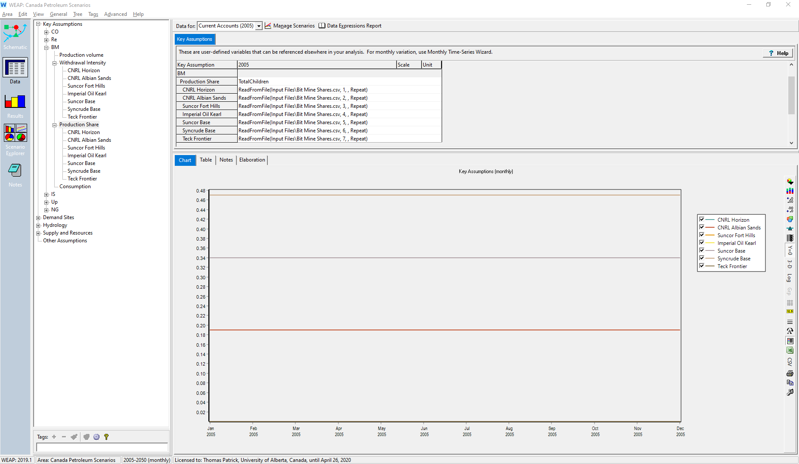
Key assumptions for bitumen mining
Withdrawal intensity by mining site
CNRL Horizon
Albian Sands
Suncor Fort Hills
Imperial Oil Kearl
Suncor Base
Syncrude Base
Production share (% of total) by site

Slide 52
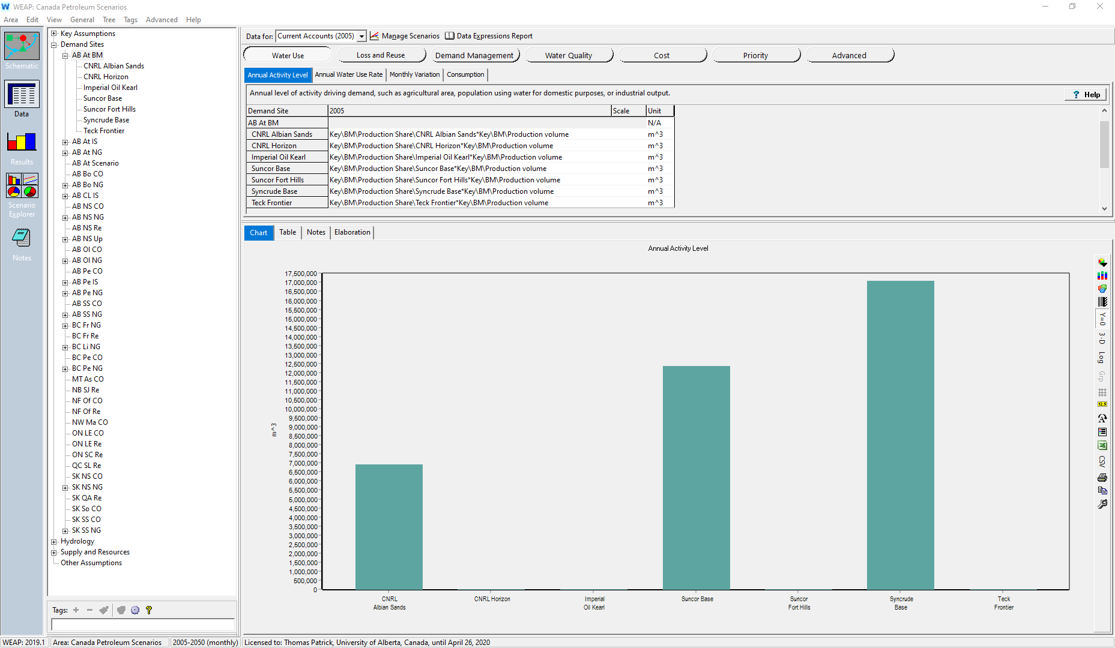
Activity by mining site
CNRL Horizon
Albian Sands
Suncor Fort Hills
Imperial Oil Kearl
Suncor Base
Syncrude Base
In base year (2005)
only three mines are
operating (Suncor,
Syncrude, and Albian
Sands)
Albian Sands
Suncor base
Syncrude base

Slide 53
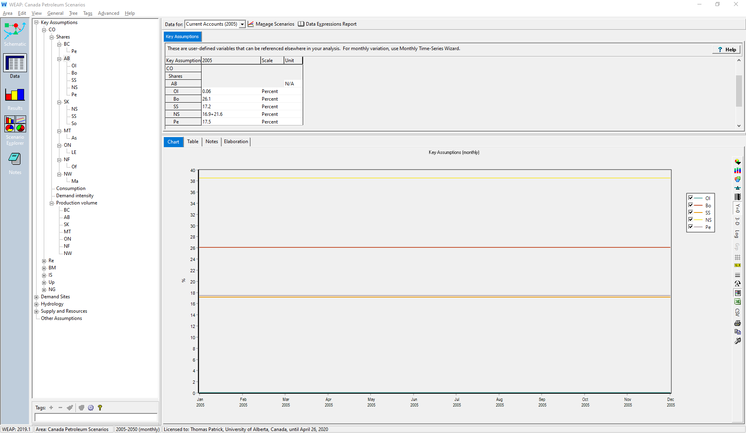
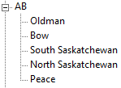
Conventional oil demand node
subdivided by river basin
Oldman: <1%
Bow: 26%
South Saskatchewan: 17%
North Saskatchewan: 39%
Peace: 18%
Key assumptions for conventional oil subsector
Withdrawal intensity (2005): 0.613 m³ water / m³ oil
(calculated from CAPP data)
Consumption: 92% (literature)
Production volume: CER data

Slide 54
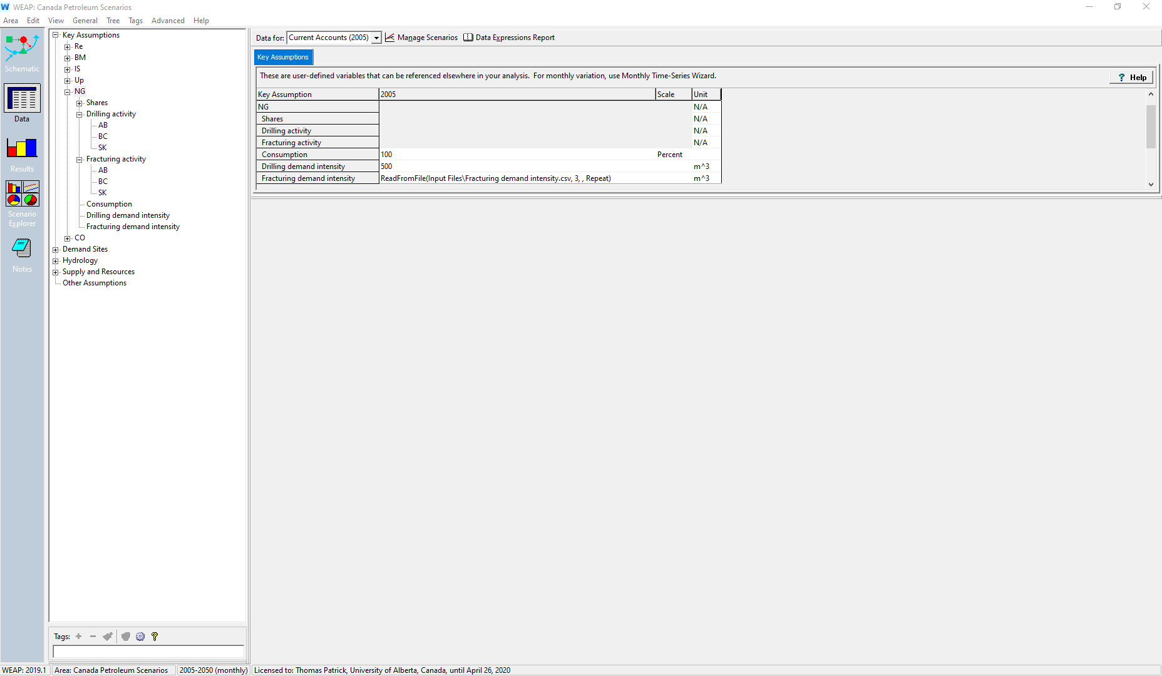
Key assumptions for natural gas subsector
Subsector has two technologies, drilling and fracturing
Activity and footprint data needed for each
Drilling data
Withdrawal intensity: 500 m³/well
(CAPP data)
Consumption: 100% (inferred)
Drilling activity: CER data
Fracturing data
Withdrawal intensity: 12,000-53,000 m³/well
(Calculated with AER and CER data)
Consumption: 100% (inferred)
Fracturing activity: CER data

Slide 55
WEAP-CANADA OIL AND GAS
Preliminary results and scenarios

Slide 56
WEAP-CANADA OIL AND GAS
RESULTS
CER reference projections for activity levels
No assumed footprint (water intensity) improvements

Slide 57
WEAP-CANADA OIL AND GAS
RESULTS
CER reference projections for activity levels
No assumed footprint (water intensity) improvements

Slide 58
WEAP-CANADA OIL AND GAS
SCENARIO BACKGROUND
CER projection to 2040, extrapolated to 2050

Slide 59
WEAP-CANADA OIL AND GAS
SCENARIO RESULTS
+36%
+18%
2018: 0%
-11%
CER reference, low, or high price projections for activity levels
No assumed footprint (water intensity) improvements

Slide 60
WEAP-CANADA OIL AND GAS
FUTURE WORK
Additional scenarios to be created for:
  Process improvements
  Technology advancement
  Regulatory policies
Integration of LEAP and WEAP

Slide 61
GENERALIZED MODELLING APPROACH
Process Modelling
Environmental Assessment/
Cost Estimation
Energy/Water Modelling
Outputs
Technology characterization
e.g. Renewable-based power generation
Environmental Modelling
(Life Cycle Assessment)
g CO₂ eq per unit output
m³ water per unit output
Water modelling
(WEAP - Water Evaluation And Planning)
Canada-wide
Water demand
Water supply
Long-term annual results per scenario
Total water withdrawal
Total water consumption
Total water savings
Specification of unit operations for each alternative pathways
Economic Modelling
(Techno-Economic Assessment)
Cost metrics
$ per unit output
Energy modelling
(LEAP - Long-range Energy Alternatives Planning)
Canada-wide
Energy demand
Energy supply
Long-term annual results per scenario
Energy demand
Technology use
GHG emissions
System costs
$/tonne of CO₂ abatement
$/liter of water saved
Characterization process equipment for unit operations
Determination of energy/resource inputs for each process equipment

Slide 62
LEAP-WEAP INTEGRATION
INTEGRATED ASSESSMENT OF ENVIRONMENTAL FOOTPRINTS FOR ENERGY PATHWAYS

Slide 63
INTEGRATED ASSESSMENT OF ENVIRONMENTAL FOOTPRINTS OF ENERGY PATHWAYS -
WHY?
Why do integrated assessments?
  Energy transition will have multifaceted impacts
  Energy transition involves systems
What energy pathways?
  GHG reduction measures
    Sector structure change
    Energy efficiency
    Technology change
    Energy and environmental policy
What environmental footprints?
  GHG emissions
  Energy use
  Freshwater use
  System costs → marginal GHG abatement cost
Energy pathways
Technology change
Impacts to water use?
System GHG reductions
System cost impacts

Slide 65
BACKGROUND – ELECTRICITY SECTOR
Electricity generation sector~ 11% of Canada’s GHG emissions
Thermal power ~ 70% water withdrawal, 11% of water consumption
Major transition underway - the impacts on water resources are unknown.
Canada’s GHG emissions by sectors in 2017
[Environment and Climate Change Canada, 2019]
Canada’s water withdrawal and consumption by sectors in 2013
[Environment and Climate Change Canada, 2016]

Slide 66
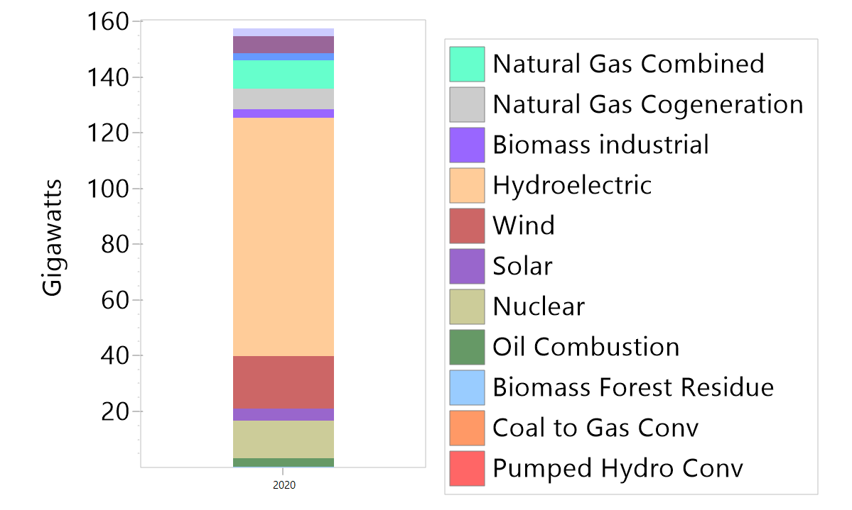
LEAP-CANADA ELECTRICITY GENERATION MODEL
Canada’s electricity sector
  Sector transition
    Annual capacity building to meet sub-annual demand
Electricity required
(Domestic demand + exports – imports)
Generation
capacity
This year
(2020)
Next year
(2021)
…
…
…
2050
Some plants reaching end of life
Electricity demands grow

Slide 67
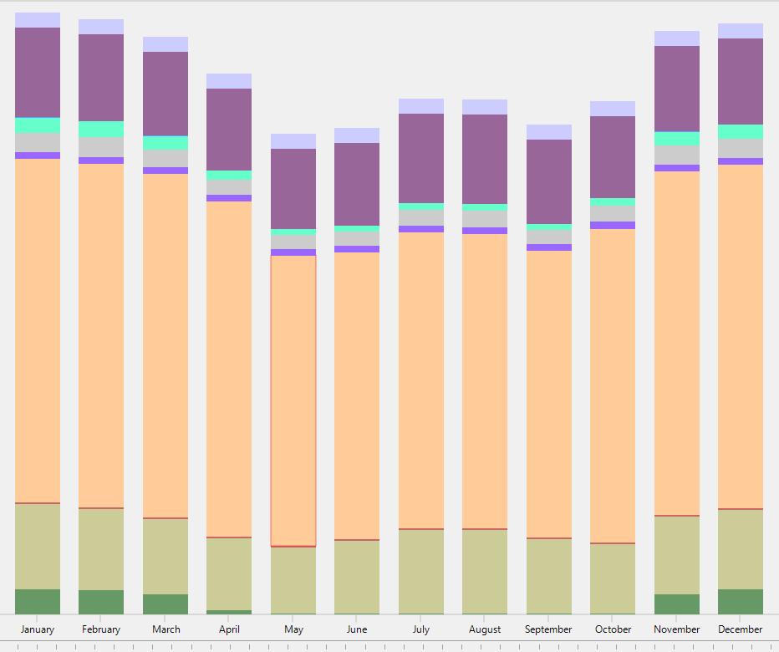
LEAP-CANADA ELECTRICITY GENERATION MODEL
Canada’s electricity sector
  Sector transition
    Annual capacity building to meet sub-annual demand
Electricity required
(Domestic demand + exports – imports)
Generation
capacity
Sub-annual
time slices
This year
(2020)
Next year
(2021)
…
…
…
2050
Some plants reaching end of life
Electricity demands grow

Slide 68
LEAP-CANADA ELECTRICITY GENERATION MODEL
Canada’s electricity sector
  Sector transition
    Annual capacity building to meet sub-annual demand
Reserve margin
Electricity required
(Domestic demand + exports – imports)
New capacity needs to be added
Choose mix of technologies that will:
Meet policy targets
Have available resources
Provide min. firm reserve margin at peak demand
Produce the lowest system NPV
Generation
capacity
This year
(2020)
Next year
(2021)
…
…
…
2050
Some plants reaching end of life
Electricity demands grow

Slide 69
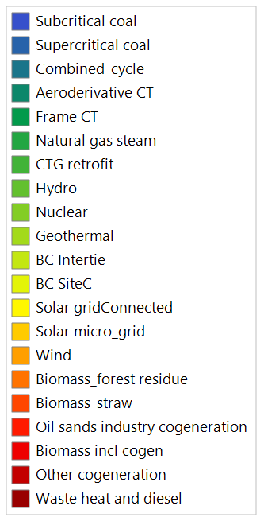
LEAP-CANADA ELECTRICITY GENERATION MODEL
Canada’s electricity sector
  Sector transition
    Annual capacity building to meet sub-annual demand
Electricity required
Generation
capacity
Generation
capacity
This year
(2020)
Next year
(2021)
…
…
…
2050

Slide 70
LEAP-CANADA ELECTRICITY GENERATION MODEL
Canada’s electricity sector
  Sector transition
    Annual capacity building to meet sub-annual demand
Electricity required
Generation
capacity
Generation
capacity
This year
(2020)
Next year
(2021)
…
…
…
2050

Slide 71
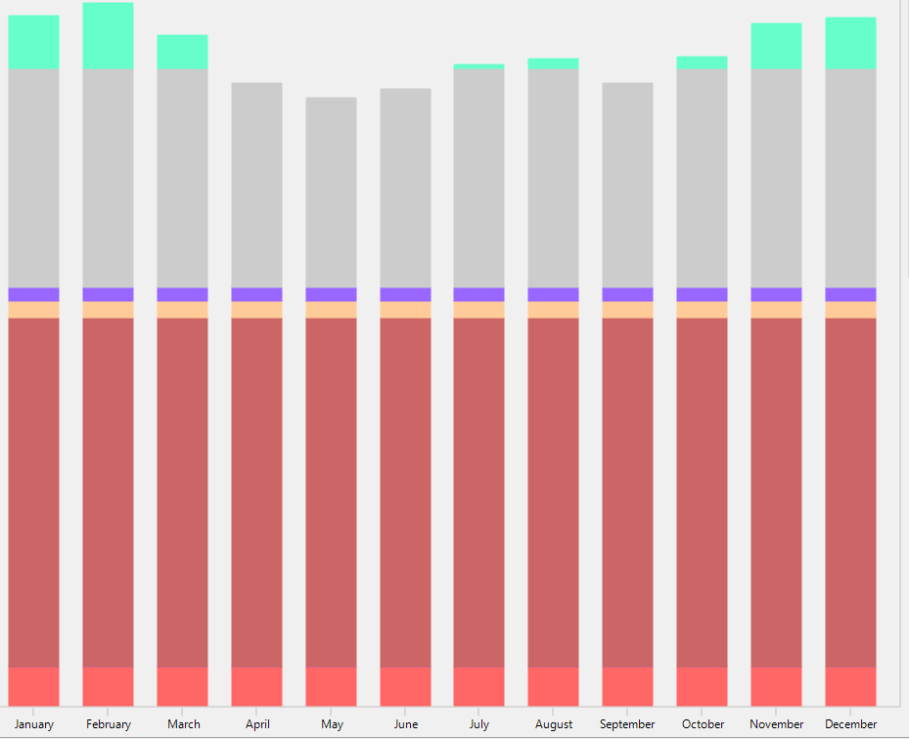
LEAP-CANADA ELECTRICITY GENERATION MODEL
Canada’s electricity sector
  Sector transition
    Annual capacity building to meet sub-annual demand
Electricity required
Dispatch based on:
-Operating cost (ղ, carbon price policy, fuel prices)
-Policy targets (Regional renewable generation requirements, carbon reduction requirements)
Generation
capacity
Generation
capacity
This year
(2020)
Next year
(2021)
…
…
…
2050

Slide 72
LEAP-CANADA ELECTRICITY GENERATION MODEL
Canada’s electricity sector
  Sector transition
    Annual capacity building to meet sub-annual demand
Electricity required
Key results:
GHG emissions
System costs
Electricity generation by technology
Generation
capacity
Generation
capacity
Link GWh of generation data to WEAP-Canada
This year
(2020)
Next year
(2021)
…
…
…
2050

Slide 73
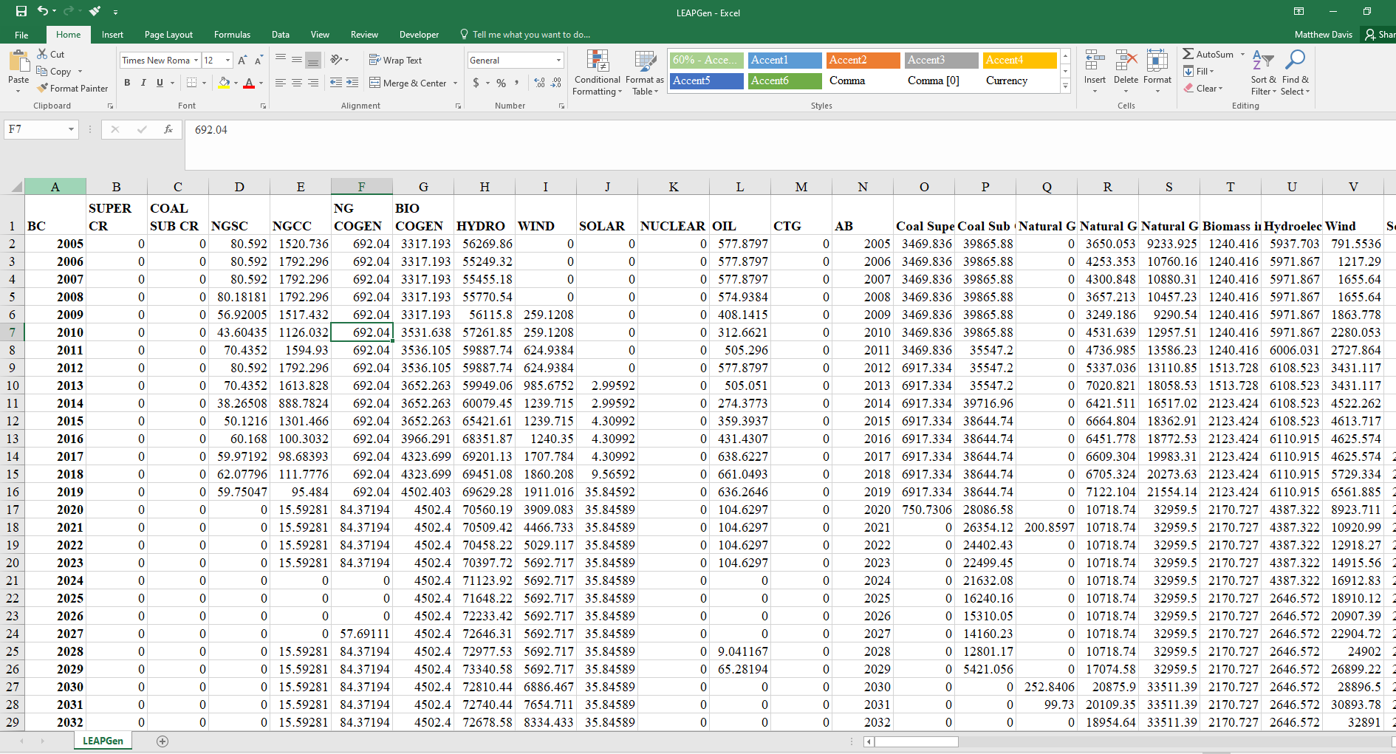
Unique for each scenario

Slide 74
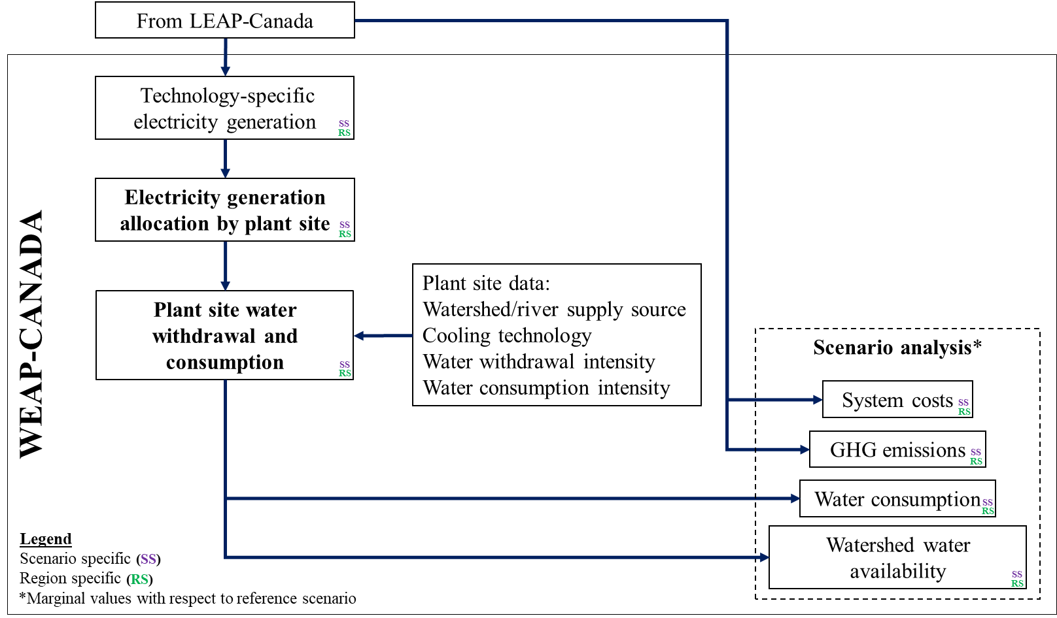
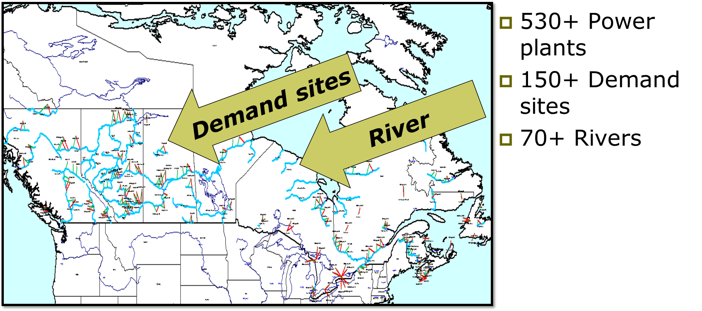
WEAP-CANADA ELECTRICITY MODEL

Slide 75
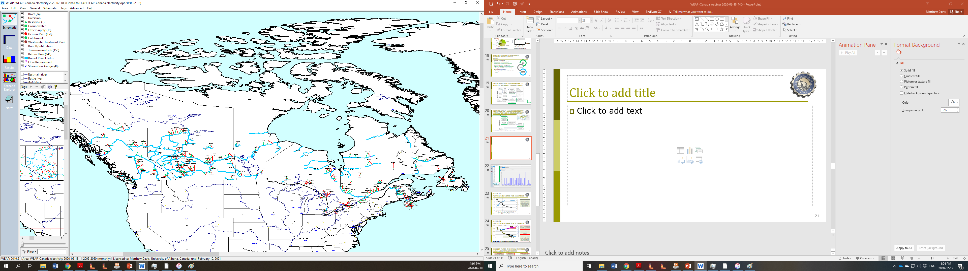
WEAP-CANADA ELECTRICITY MODEL

Slide 76
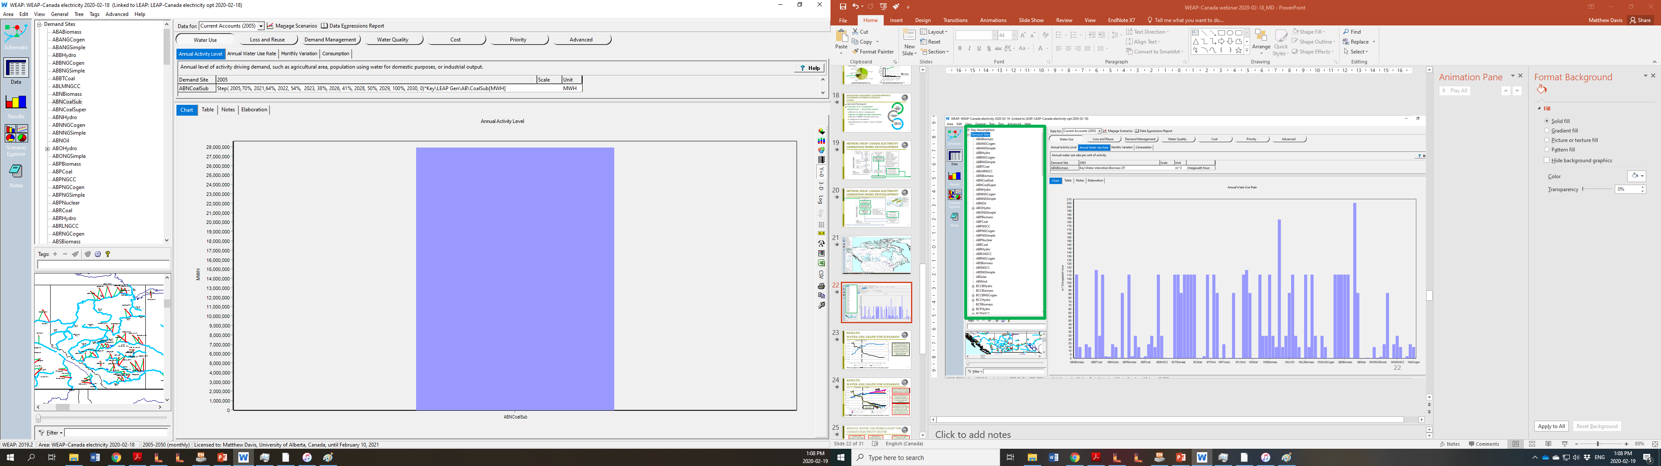
Annual activity level for demand site

Slide 77
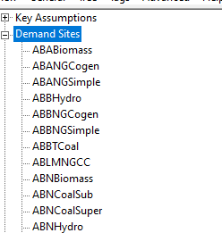

Slide 78
Annual activity level for demand site
Share of generation from watershed
MWhs of generation from LEAP

Slide 79
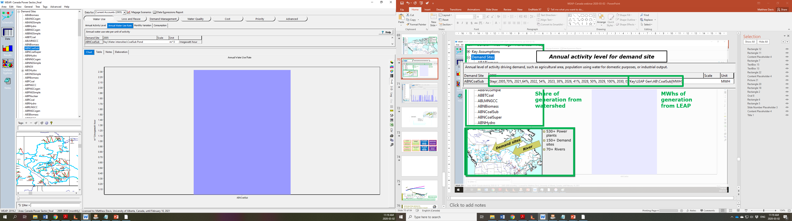

Slide 80
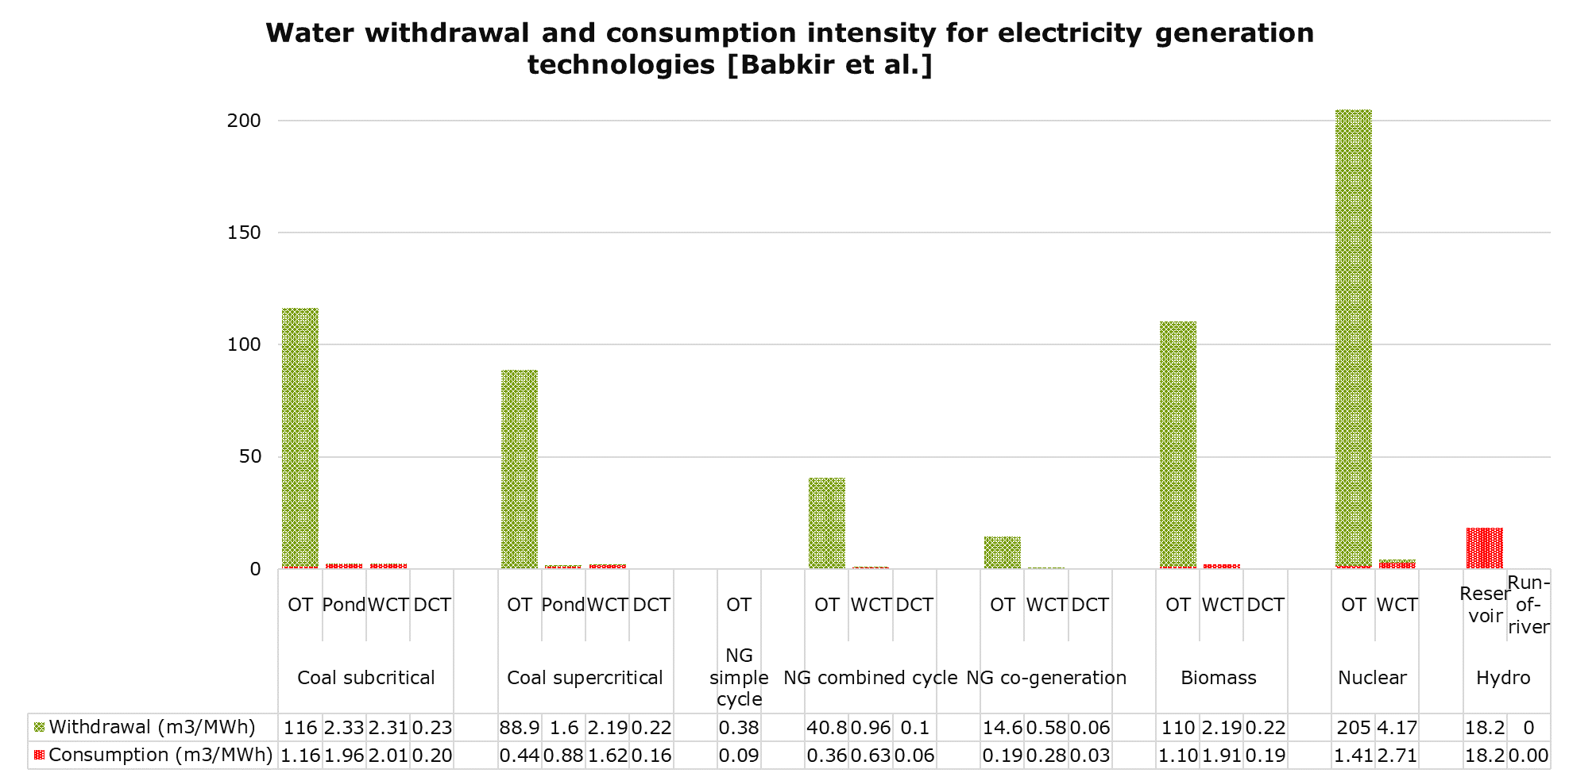

Life cycle water footprints

Slide 81
WEAP-CANADA ELECTRICITY MODEL

Slide 82
GENERALIZED MODELLING APPROACH
Process Modelling
Environmental Assessment/
Cost Estimation
Energy/Water Modelling
Outputs
Technology characterization
e.g. Renewable-based power generation
Environmental Modelling
(Life Cycle Assessment)
g CO₂ eq per unit output
m³ water per unit output
Water modelling
(WEAP - Water Evaluation And Planning)
Canada-wide
Water demand
Water supply
Long-term annual results per scenario
Total water withdrawal
Total water consumption
Total water savings
Specification of unit operations for each alternative pathways
Economic Modelling
(Techno-Economic Assessment)
Cost metrics
$ per unit output
Energy modelling
(LEAP - Long-range Energy Alternatives Planning)
Canada-wide
Energy demand
Energy supply
Long-term annual results per scenario
Energy demand
Technology use
GHG emissions
System costs
$/tonne of CO₂ abatement
$/liter of water saved
Characterization process equipment for unit operations
Determination of energy/resource inputs for each process equipment

Slide 83
INTEGRATING RESULTS:
WATER-GHG PROJECTION
Historical
Future
Water consumption
from WEAP
GHG emissions from LEAP
Example - least cost electricity system scenario results

Slide 84
INTEGRATING RESULTS:
WATER-GHG CHANGE FOR SCENARIO
Historical
Future
Change due to decarbonization scenario
Baseline water consumption
(blue line)
Baseline GHG emissions (blackline)

Slide 85
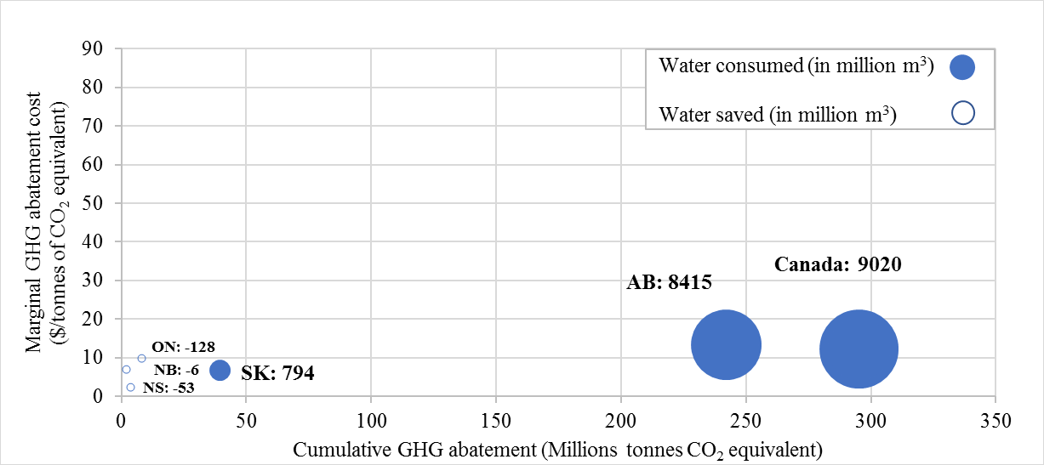
INTEGRATING RESULTS:
WATER-GHG-COST BUBBLE CHART
(2020-2050)
Example - Water-GHG-cost tradeoffs for decarbonization scenario compared to baseline

Slide 86
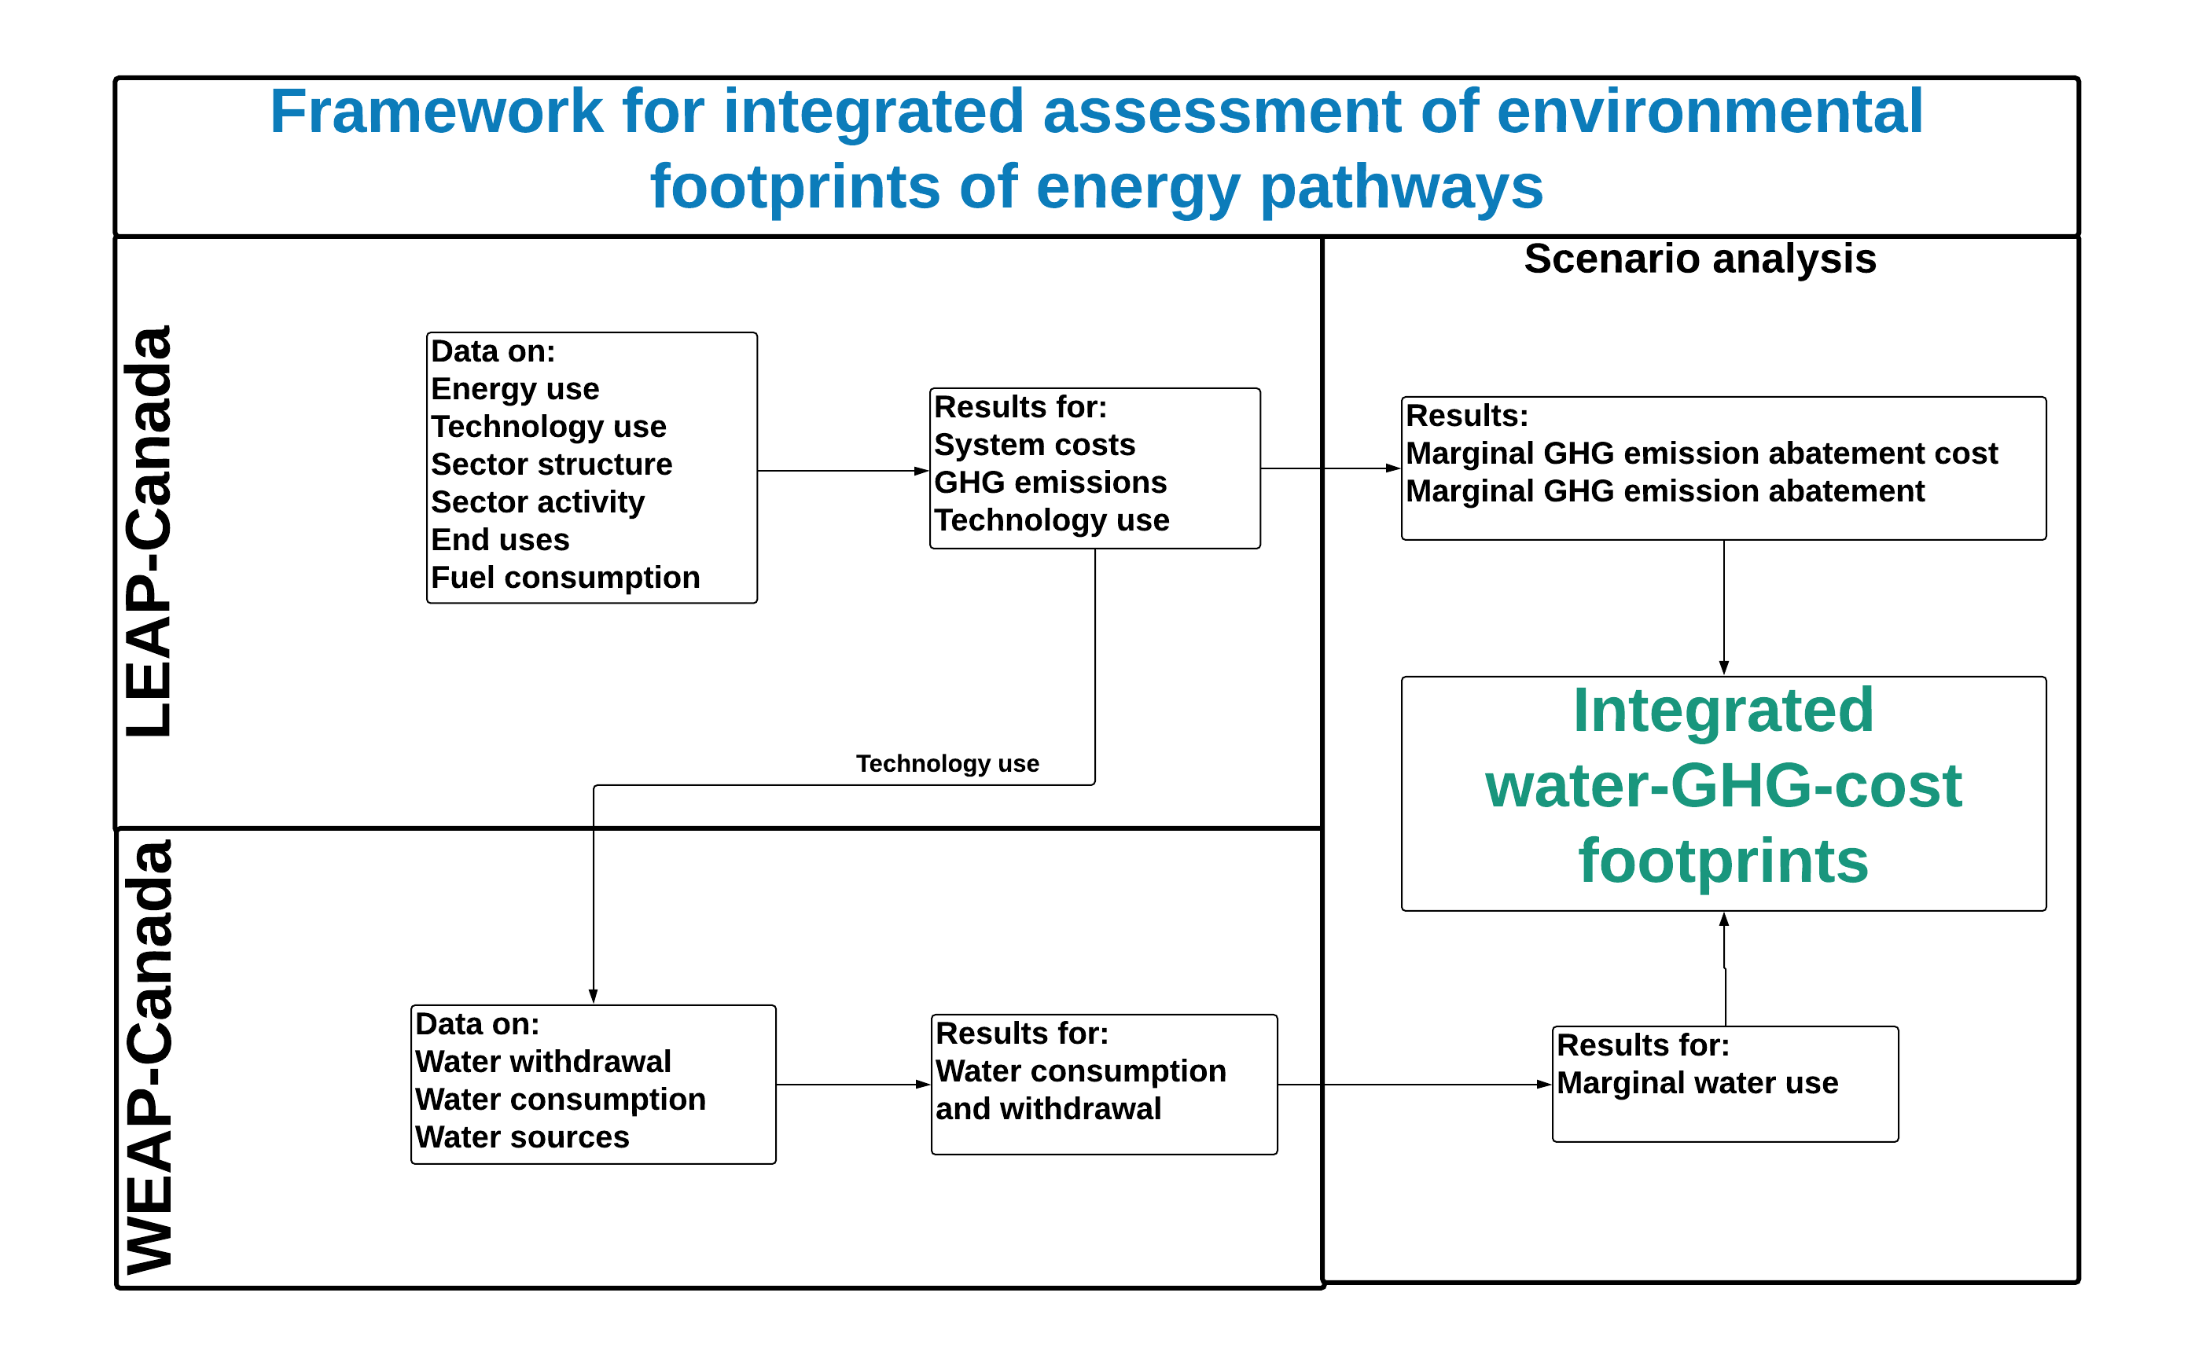

Slide 87
LEAP-WEAP-CANADA
FUTURE WORK
Additional scenarios to be created for:
Process improvements
  Technology advancement
  Regulatory policies
Integration of LEAP and WEAP

Slide 88
LIST OF OUR RESEARCH
WITH LEAP & WEAP

Slide 89
PUBLICATIONS, IN-REVIEW PAPERS
1/2
GHG mitigation assessments:
Subramanyam V, Kumar A, Talaei A, Mondal MAH. Energy efficiency improvement opportunities and associated greenhouse gas abatement costs for the residential sector, Energy, 2017, 118: 795-807.
Subramanyam V, Ahiduzzaman M, Kumar A. Greenhouse gas emissions mitigation potential in the commercial and institutional sector, Energy and Buildings, 2017, 140: 295-304.
Bonyad M, Shafique HU, Mondal MAH, Subramanyam V, Kumar A, Ahiduzzaman M. Development of a framework for the assessment of energy demand-based greenhouse gas mitigation options for the agriculture sector, Transactions of the ASABE, 2018, 61:763.
Talaei A, Ahiduzzaman M, Kumar A. Assessment of Long-term energy efficiency improvement and greenhouse gas emissions mitigation potentials in the chemical sector, Energy, 2018; 153: 231-47.
Talaei A, Pier D, Iyer AV, Ahiduzzaman M, Kumar A. Assessment of long-term energy efficiency improvement and greenhouse gas emissions mitigation options for the cement industry, Energy, 2019, 170:1051-1066.
Katta AK, Davis M, Subramanyam V, Dar AF, Mondal MAH, Ahiduzzaman M, Kumar A. Assessment of energy demand-based greenhouse gas mitigation options for Canada’s oil sands, Journal of Cleaner Production, 2019, 241: 118306.
Talaei A, Oni O, Ahiduzzaman M, Roychaudhuri PS, Rutherford J, Kumar A. Assessment of the impacts of process-level energy efficiency improvement on the greenhouse gas mitigation potential in the petroleum refining sector, Energy, In Press, 2019.
Talaei A, Ahiduzzaman M, Kumar A. Potential for energy efficiency improvement and greenhouse gas mitigation from Canada’s iron and steel industry, 2019. (in review)
Katta A, Davis M, and Kumar A, Assessment of greenhouse gas mitigation options for the iron, gold, and potash mining sectors, Journal of Cleaner Production, vol. 245, p. 118718, 2020.
Janzen R, Davis M, and Kumar A, Greenhouse gas emission abatement potential and associated costs of integrating renewable and low carbon energy technologies into the Canadian oil sands., Submitted., 2019.
Janzen R, Davis M, and Kumar A, An assessment of opportunities for cogenerating electricity to reduce greenhouse gas emissions in the oil sands., Submitted., 2020.
Janzen R, Davis M, and Kumar A, Evaluating long-term greenhouse gas mitigation opportunities through carbon capture, utilization, and storage in the oil sands., Submitted., 2020.
Davis M, Moronkeji A, Ahiduzzaman M, and Kumar A, The development of an energy-environment model for assessing renewable generation pathways for a fossil fuel-based electricity-producing jurisdiction, Submitted, 2020.

Slide 90
PUBLICATIONS, IN-REVIEW PAPERS
2/2
Energy assessments:
Subramanyam V, Paramshivan D, Kumar A, Mondal MAH. Using Sankey diagrams to map energy flow from primary fuel to end use, Energy Conversion and Management, 2015, 91: 342-52.
Davis M, Ahiduzzaman M, Kumar A. How will Canada’s greenhouse gas emissions change by 2050? A disaggregated analysis of past and future greenhouse gas emissions using bottom-up energy modelling and Sankey diagrams, Applied Energy, 2018, 220: 754-86.
Davis M, Ahiduzzaman M, Kumar A. Mapping Canadian energy flow from primary fuel to end use, Energy Conversion and Management, 2018, 156: 178-91.
Davis M, Ahiduzzaman M, Kumar A. How to model a complex national energy system? Developing an integrated energy systems framework for long-term energy and emissions analysis, International Journal of Global Warming, 2019, Vol. 17, No. 1.
Katta AK, Davis M, and Kumar A, Development of disaggregated energy use and greenhouse gas emission footprints in Canada’s iron, gold, and potash mining sectors, Resources, Conservation and Recycling, vol. 152, p. 104485, 2020.
Life cycle water assessments:
Ali B, and Kumar A, Development of life cycle water-demand coefficients for coal-based power generation technologies, Energy Conversion and Management, vol. 90, pp. 247-260, 2015.
Ali B, and Kumar A, Development of life cycle water footprints for gas-fired power generation technologies, Energy Conversion and Management, vol. 110, pp. 386-396, 2016.
Ali B, and Kumar A, Development of water demand coefficients for power generation from renewable energy technologies, Energy Conversion and Management, vol. 143, pp. 470-481, 2017.
Ali B, and Kumar A, Development of life cycle water footprints for oil sands-based transportation fuel production, Energy, vol. 131, pp. 41-49, 2017.
Ali B, and Kumar A, Life cycle water demand coefficients for crude oil production from five North American locations, Water Research, vol. 123, pp. 290-300, 2017.
Integrated assessments:
Agrawal N, Ahiduzzaman M, and Kumar A, The development of an integrated model for the assessment of water and GHG footprints for the power generation sector, Applied Energy, vol. 216, pp. 558-575, 2018.

Slide 91
CURRENT WORK
GHG mitigation assessments:
Shafique U, Davis M, Owttrim C, Paul P, Ahiduzzaman A, Kumar A. Development of a framework for the Assessment of Energy Demand based GHG Mitigation Options for the Alberta Pulp and Paper Sector.
Haider M, Davis M, Subramanyam V, Kumar A, Radpour S, Mondal A, Ahiduzzaman A. Assessment of Greenhouse Gas Mitigation Options for the Transportation Sector using the LEAP Model.
Energy assessments:
Owttrim C, Davis M, Kumar A. Development of long-term energy efficiency potential in the pulp and paper sector.
Radpour S, Owttrim C, Davis M, Talaei A, Kumar A. Development of long-term energy efficiency potential in the iron and steel sector.
Water assessments:
Agrawal N, Patrick T, Davis M, Gemechu E, Ahiduzzaman A, Kumar A. Mapping water flows in Canada with Sankey diagrams.
Patrick T, Gupta A, Davis M, Kumar A. Development of an oil and gas water evaluation and planning model.

Slide 92
ACKNOWLEDGMENTS
Thanks to the NSERC/Cenovus/Alberta Innovates Associate Industrial Research Chair in Energy and Environmental Systems Engineering and the Cenovus Energy Endowed Chair in Environmental Engineering for providing financial support.
We are also grateful to representatives from Alberta Innovates, Suncor Energy Inc., Cenovus Energy Inc., Natural Resources Canada, and Environment and Climate Change Canada for their valuable inputs and comments in various forms.
As a part of the University of Alberta's Future Energy Systems (FES) research initiative, this research was made possible in part thanks to funding from the Canada First Research Excellence Fund (CFREF).

