Slide 1
DEVELOPMENT OF FUNNEL MODEL FOR ESTIMATION OF LIFE CYCLE GHG EMISSIONS OF VARIOUS TRANSPORTATION FUELS
NSERC/Cenovus/Alberta Innovates Associate Industrial Chair Program in Energy and Environmental Systems Engineering
www.energysystems.ualberta.ca
Webinar
November 19, 2019
Abayomi Oni, Giovanni Di Lullo, Nafisa Mahbub, Amit Kumar
Department of Mechanical Engineering, University of Alberta, Edmonton, Canada

Slide 2
OVERALL STRUCTURE OF THE NSERC INDUSTRIAL RESEARCH CHAIR PROGRAM

Slide 3
WEBINAR OUTLINE
Background
The FUNNEL model
Examples of applications
Questions – Please indicate or type your question in the chat box
Sensitivity and uncertainty analysis in FUNNEL-RUST

Slide 4
CHALLENGES WITH EXISTING MODELS
Models are process specific
  Inaccurate results when plant configuration or feed is modified
  Limited ability to consider future technologies
  Limited to fossil fuels
Models use aggregated or confidential data
  Unable to consider/model alternative or future pathways
  Cannot avoid unnecessary assumptions
  Data not available in public domain
Models do not always consider full life cycle of products
Models are deterministic
  Need to quantify uncertainty
  Sensitivity analysis is generally simplistic

Slide 5
THE FUNNEL MODEL
What is FUNNEL?
FUNdamental ENgineering PrinciplEs-based ModeL for Estimation of GreenHouse Gases (FUNNEL-GHG)
FUNNEL was developed to accurately evaluate LCA greenhouse gas emission from various energy systems
Developed regression, uncertainty, and sensitivity tool (RUST)

Slide 6
FUNNEL
Liquid
Fossil Fuel
Gaseous
Fossil Fuel
Renewables
OME
Liquid Biofuel
Conventional
Crude Oil
Conventional
Natural Gas
HDRD
Hydrogen
Oil Sands
LNG
Hydro
Power
Algae
Biomass
Pyrolytic
Oil
Wind
Future
Technologies
Transmission
Lines
Energy
Storage
With
Storage
NSolve
ESEIEH
Solar
THAI
Biomass / Pellets for
Heat/Electricity
Pipeline vs.
Rail Transport

Slide 7
FUNNEL DATA FLOW
FUNNEL
Regression, Uncertainty, Sensitivity Tool
(RUST)
Process Models
ASPEN HYSYS
ASPEN Plus
Custom Solvers
Literature
Correlations
Government Databases
Industry Reports
Canada-Wide
Long Range
Energy Planning
(LEAP) Model

Slide 8

  INTEGRATING FUNNEL TO PROCESS MODELING TOOLS
Process simulation
Life cycle GHG
estimation in FUNNEL

Slide 9
  INTEGRATING FUNNEL TO PROCESS MODELING TOOLS
  Simulation steps:
  Define the simulation basis
  Characterize feeds
  Install and/or calibrate unit operations
  Run simulation program
  Validate results

Slide 10
FUNNEL: LCA OF TRANSPORTATION FUELS FROM CONVENTIONAL AND UNCONVENTIONAL CRUDE OIL
Electricity,
Natural
Gas
Electricity,
Natural
Gas
Electricity,
Natural
Gas
Electricity,
Diesel
Electricity,
Diesel
Diesel
Refining
Distribution
To Bulk Terminal
  Pipeline
  Rail
  Truck
  Barge
  Ocean Tanker
To Refueling Station via Truck
Surface Processing
Crude Stabilizer
Gas Dehydrator
Acid Gas Treat.
Water Treat.
Crude Trans.
Pipeline
Ocean Tanker
Site Prep.
Well Drilling
Land Use
Extraction
Injection
Lifting
Fuel
Comb.
Emissions
Emissions
Emissions
Emissions
Emissions
Emissions
Emissions
Functional Unit: gCO₂eq/MJ
Allocation Method: Energy

Slide 11
Demonstrating
FUNNEL

Slide 12
FUNNEL FRAMEWORK
RUST
Sensitivity & Uncertainty Analysis
Excel
Interface
Output
gCO₂eq/MJ
User Data
Process Modeling

Slide 13
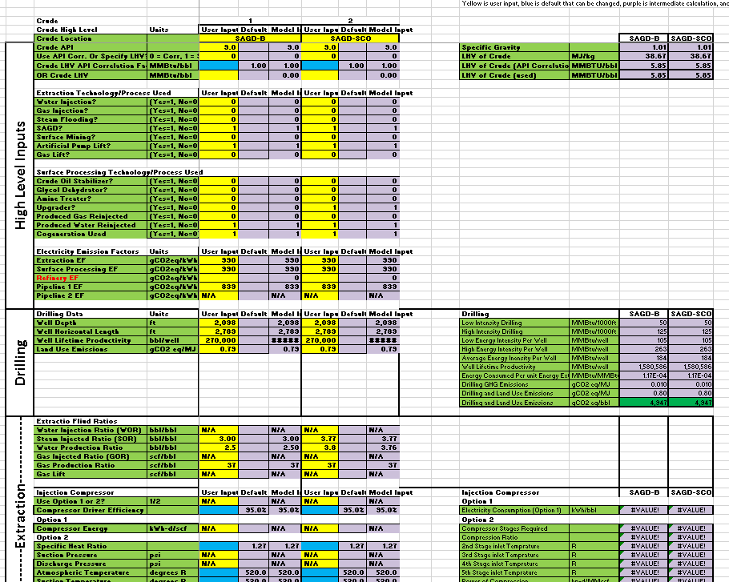
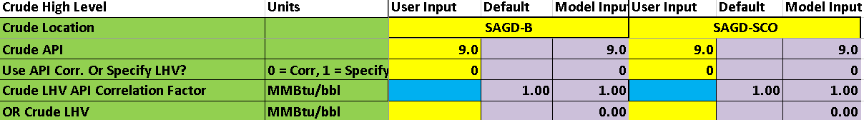
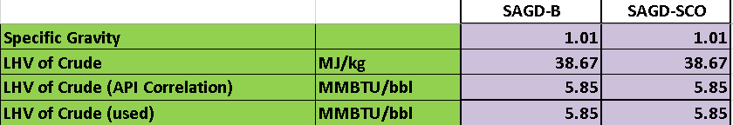
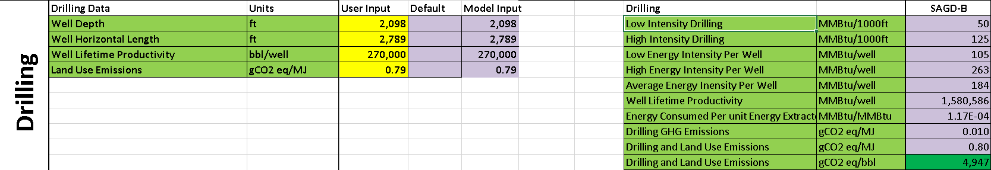
INTERFACE OVERVIEW
Color Coding
  Yellow: Required
  Blue: Override recommended
  Purple: Intermediate value
  Green: Output values
User Inputs
Intermediate &
Output Values
User Inputs
Intermediate &
Output Values
Model
Subsection
Model
Subsection

Slide 14

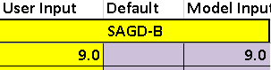
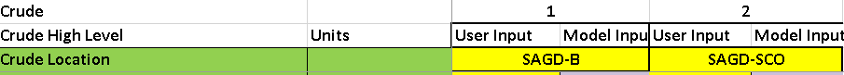
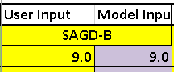
INTERFACE OVERVIEW: NAVIGATION
Jump to Model Subsection
Show/Hide
All Scenarios
Hide Columns
Show/Hide Side-By-Side Scenarios

Slide 15
FUNNEL INPUTS EXAMPLE FOR LIQUID FOSSIL FUEL PATHWAYS

Slide 16
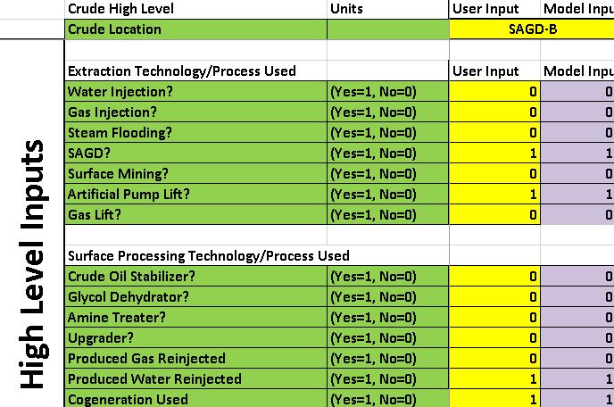
HIGH LEVEL INPUTS
Specify Technology Pathways
Electricity EF can be specified for each stage
  Based on where it is consumed

Slide 17
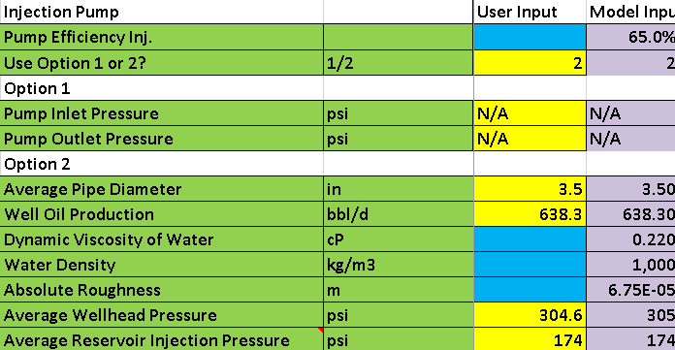
FUNNEL DATA INPUT OPTIONS
Multiple calculation options for flexibility

Slide 18
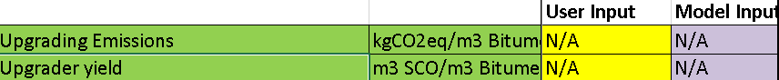
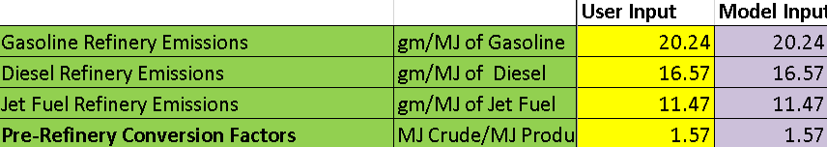
UPGRADER AND REFINERY INTEGRATION
Currently pulls data from separate Excel book
Input crude oil properties
Calculations use rigorous Aspen Hysys model

Slide 19
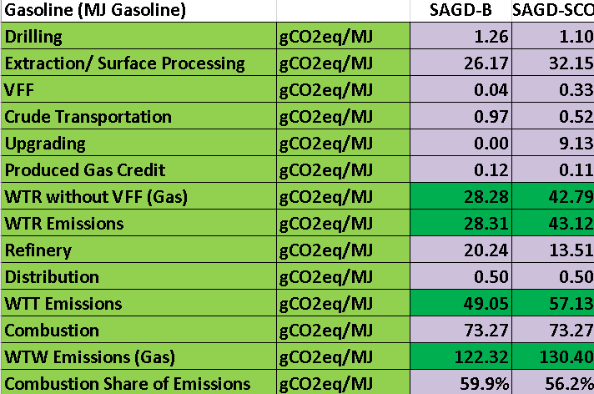
FUNNEL OUTPUT
Output for gasoline results
Similar table for diesel and jet fuel

Slide 20
Sensitivity and Uncertainty Analysis using RUST

Slide 21
REGRESSION, UNCERTAINTY, AND SENSITIVITY TOOL (RUST) FOR LCA
Purpose: Streamline LCA process
  Minimize data requirements
Developed for Excel based LCA
  Expanded for use with external models
Includes
  Morris (parameter screening)
  Monte Carlo uncertainty (output uncertainty)
  Sobol contribution to variance (source of uncertainty)
  Multiple parameter linear regression (proxy modeling)

Slide 22
FUNNEL-RUST:
METHODOLOGY FOR LCA
Reduce data collection workload
Three stages
  Screen for key inputs
  Evaluate output uncertainty
  Refine input uncertainty as needed
Determine conservative ranges for all inputs
Morris sensitivity analysis
Parameter sensitivities
No
Refine ranges
Acceptable?
Yes
Probability distributions
Identify key inputs
Perform Monte Carlo
Refine distributions
Output distribution
Input Sobol indices
Uncertainty range
acceptable?
No
Perform Sobol analysis
Yes
End

Slide 23
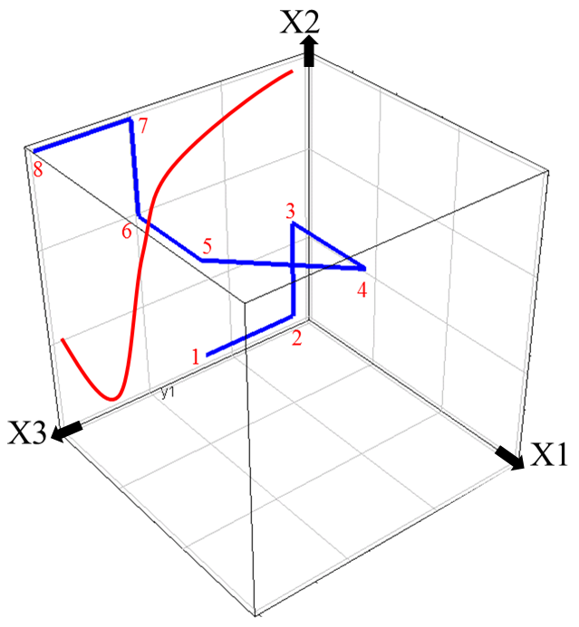
FUNNEL-RUST:
SENSITIVITY ANALYSIS / SCREENING
 | One-at-a-time (OAT) (Local) | Morris (Global)
Scope | Centered at base case | Explore entire parameter space
Effects | Primary | Primary and interaction
Applicable for | Simple models (linear, aggregated data) | Complex models (non-linear, process/engineering models)
Sampling Method

Slide 24
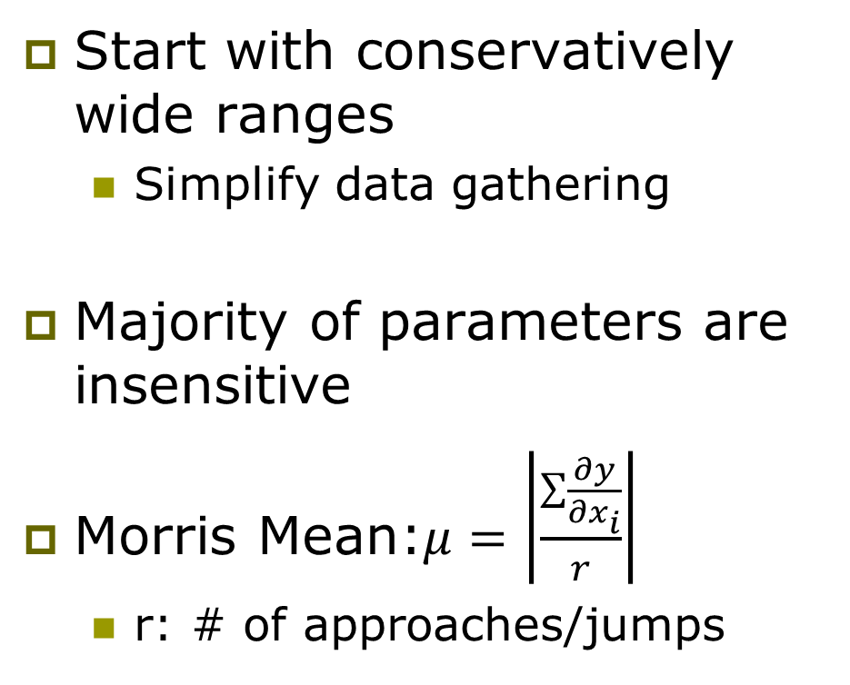
FUNNEL-RUST:
MORRIS SCREENING METHOD
Gasoline from Maya Crude (Base Case ~100gCO₂eq/MJ)
Start with conservatively wide ranges
  Simplify data gathering
Majority of parameters are insensitive
Morris Mean:$μ=\left|\frac{\sum{\frac{∂y}{∂x_{i}}}}{r}\right|$
  r: # of approaches/jumps

Slide 25
FUNNEL-RUST:
UNCERTAINTY SOURCES
Empirical / Parameter
  Due to measurement error (flared gas volume), estimating error, variability (SAGD SOR), etc.
Value or Domain (Normative)
  Decided by modeler / stakeholders
  Subjective
  Time horizon, allocation method etc.
Model
  Simplifications
  Error in physical constants
  Extrapolating from similar process

Slide 26
FUNNEL-RUST:
REPRESENTING UNCERTAINTY
Distrib. | When to use
Uniform | Most conservative
Triangle | Assumed central tendency
PERT | Expected normal distribution
Statistical | Large amount of data
Mindset
  Statistical – pure error
  Bayesian – authors confidence
Probabilities
  Convenient single output
  Effects of normative choices is
  unclear
Scenarios
  Clearly shows effect on normative choices
  Large number of outputs

Slide 27
FUNNEL-RUST:
SOBOL CONTRIBUTION OF VARIANCE
What share of output variance does each input contribute?

Slide 28
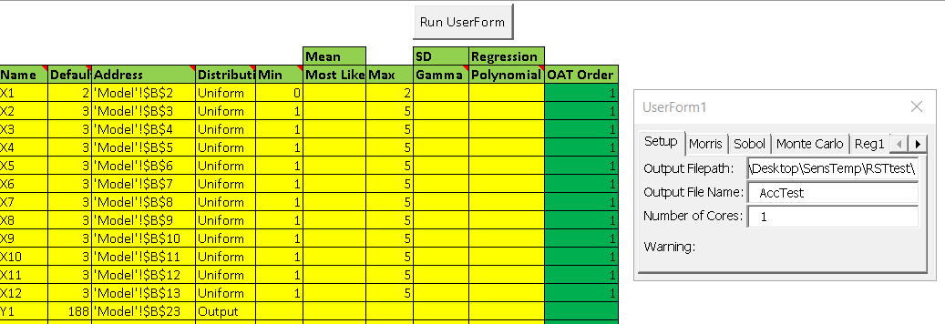
FUNNEL-RUST: INTERFACE
Activate UserForm
Model Inputs
Simulation
Inputs
Input Simulation
Parameters

Slide 29
FUNNEL Example Results

Slide 30
FUNNEL APPLICATIONS EXAMINED
Three Transportation Fuel LCA:
  Application 1: Conventional and Unconventional Crude Oil
  Application 2: Future Bitumen Extraction Technology
  Application 3: Biofuels, Oxymethylene Ether (OME)

Slide 31
FUNNEL Application 1:
Transportation Fuels from Conventional and Unconventional Crude Oil

Slide 32
FUNNEL APPLICATION 1 CRUDE & BITUMEN: CURRENT SCENARIOS
Crude | ºAPI | Extraction Technology | Crude Location | Refinery Location
Maya | 22.0 | N₂ inj.& gas lift | Mexico | Houston, TX
Mars | 31.5 | Water inj. | U.S. Gulf Coast | Cushing, OK
Bow River | 24.7 | Water inj. & pump lift | Canada | Cushing, OK
Alaska | 31.9 | WAG inj. | Alaska | L.A, CA
Prudhoe Bay | 31.9 | WAG inj. | Alaska | L.A, CA
Kern | 13.0 | Steam inj. & pump lift | California | L.A, CA
Vene | 11.7 | Steam inj. | Venezuela | Houston, TX
Sirri | 31.0 | Water inj. | Iran | Houston, TX
Arab Light | 32.6 | Water inj. | Saudi Arabia | Houston, TX
Bitumen | 8.2 | SAGD & Mining | Alberta | Cushing, OK
SCO | 32.8 | SAGD & Mining | Alberta | Cushing, OK

Slide 33
FUNNEL APPLICATION 1 CRUDE & BITUMEN: COMPARISON OF FUNNEL TO LITERATURE
Source of Variance
  Different refinery configurations
  VFF emissions are higher in FUNNEL

Slide 34
FUNNEL APPLICATION 1 CRUDE & BITUMEN: RESULTS
Emissions unlikely correlated to API

Slide 35
FUNNEL Application 2:
Future Bitumen Extraction Technology

Slide 36
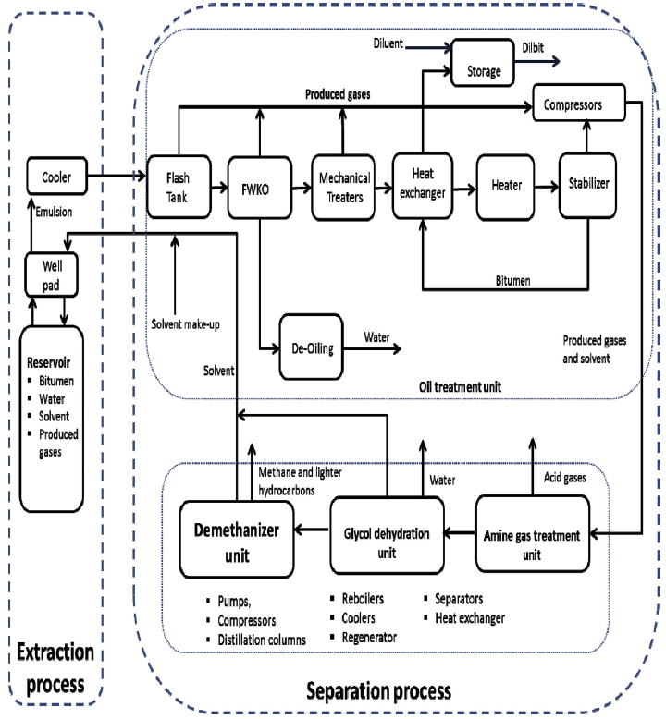
FUNNEL APPLICATION 2 FUTURE TECH.:
SCHEMATIC DIAGRAM OF THE ESEIEH PROCESS
ESEIEH: Enhanced Solvent Extraction Incorporating Electromagnetic Heating technology
Bitumen is separated as dilbit
Solvent (butane) is separated and purified
Heating device

Slide 37
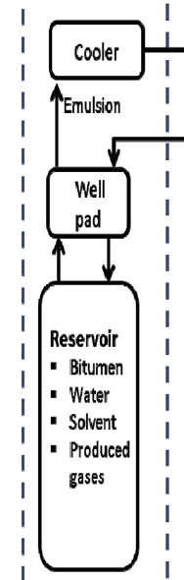
FUNNEL APPLICATION 2 FUTURE TECH.:
SCHEMATIC DIAGRAM OF THE ESEIEH PROCESS

Slide 38
FUNNEL APPLICATION 2 FUTURE TECH.:
SCHEMATIC DIAGRAM OF THE ESEIEH PROCESS
ESEIEH: Enhanced Solvent Extraction Incorporating Electromagnetic Heating technology
Bitumen is separated as dilbit
Solvent (butane) is separated and purified
Heating device

Slide 39
FUNNEL APPLICATION 2 FUTURE TECH.:
SCHEMATIC DIAGRAM OF THE ESEIEH PROCESS

Slide 40
FUNNEL APPLICATION 2 FUTURE TECH.:
SCHEMATIC DIAGRAM OF THE ESEIEH PROCESS
ESEIEH: Enhanced Solvent Extraction Incorporating Electromagnetic Heating technology
Bitumen is separated as dilbit
Solvent (butane) is separated and purified
Heating device

Slide 41
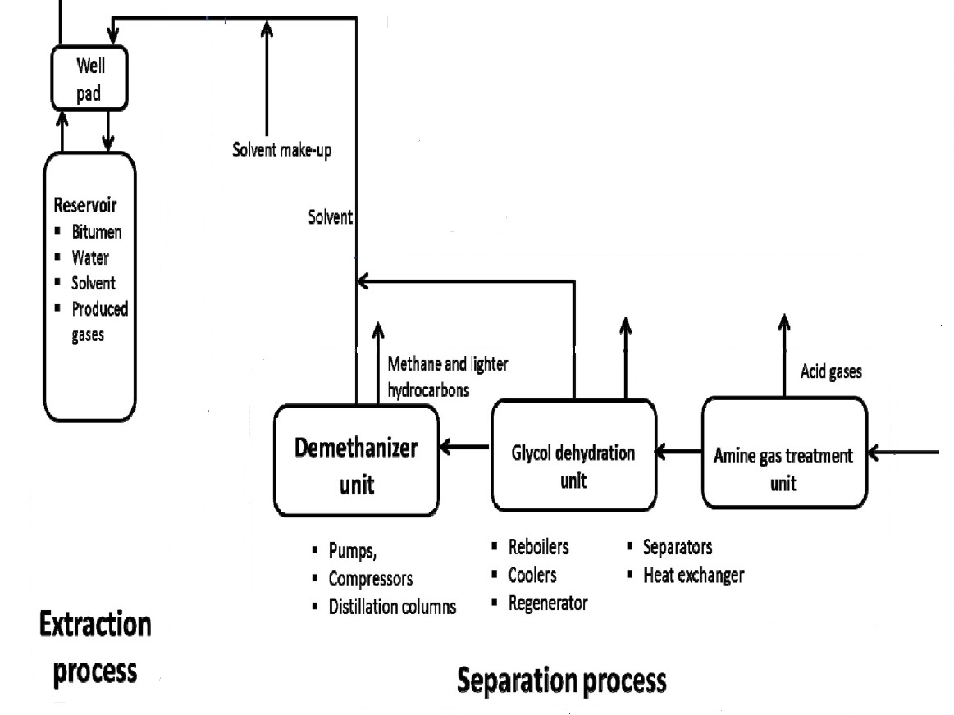
FUNNEL APPLICATION 2 FUTURE TECH.:
SCHEMATIC DIAGRAM OF THE ESEIEH PROCESS
Produced
gases

Slide 42
FUNNEL APPLICATION 2 FUTURE TECHNOLOGY: ESEIEH PATHWAYS
Process simulation was developed for ESEIEH pathways
Aspen HYSYS simulation results were integrated into FUNNEL
Two pathways were considered for ESEIEH process
  In Pathway I, the produced gases are captured to minimize solvent losses, while Pathway II considers their use as fuel
ESEIEH: Enhanced Solvent Extraction Incorporating Electromagnetic Heating Technology

Slide 43
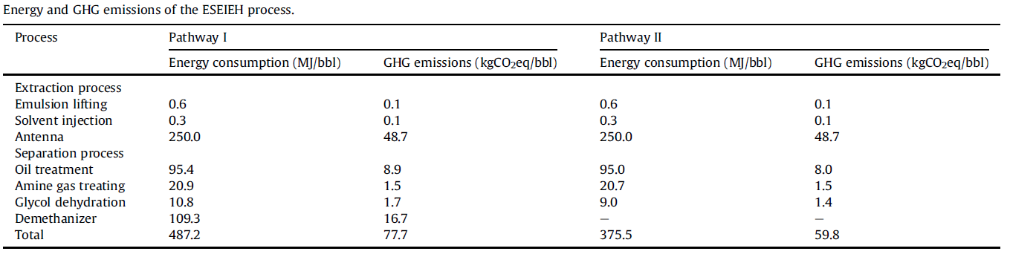
FUNNEL APPLICATION 2 FUTURE TECHNOLOGY:
LIFE CYCLE GHG EMISSION OF THE ESEIEH PROCESS
ESEIEH: Enhanced Solvent Extraction Incorporating Electromagnetic Heating Technology

Slide 44
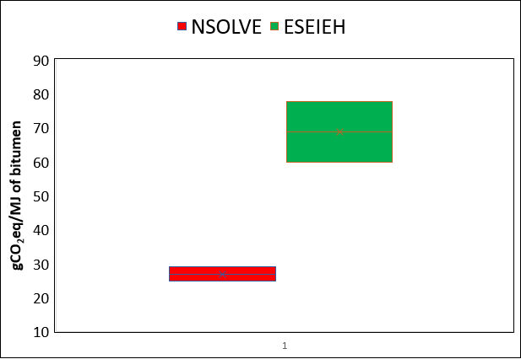
FUNNEL APPLICATION 2 FUTURE TECH.: COMPARING ESEIEH WITH NSOLVE
Scenario analysis shows that ESEIEH process can be improved (9.96 kgCO₂eq./bbl) by reducing the grid emission intensity
SAGD: 45 – 190 kgCO₂ eq./bbl
ESEIEH: Enhanced Solvent Extraction Incorporating Electromagnetic Heating Technology
Solvent Extraction Technology by Nsolve

Slide 45
FUNNEL Application 3:
LCA of Biofuel

Slide 46
FUNNEL APPLICATION 3 BIOFUEL:
OXYMETHYLENE ETHER (OME)
What is oxymethylene ether?
  OME is an oxygenated compound used as a diesel additive in vehicles.
  Can be used in old in-use vehicles; no engine modifications.
  Can reduce soot emissions: 10% OME in 90% diesel reduced soot emissions by 18%
Why oxymethylene ether?
  Unlimited miscibility with diesel
  Properties comparable with diesel: cetane number, flash point, auto ignition point
  Drawbacks of other alternative fuels: DME, biodiesel, methanol

Slide 47
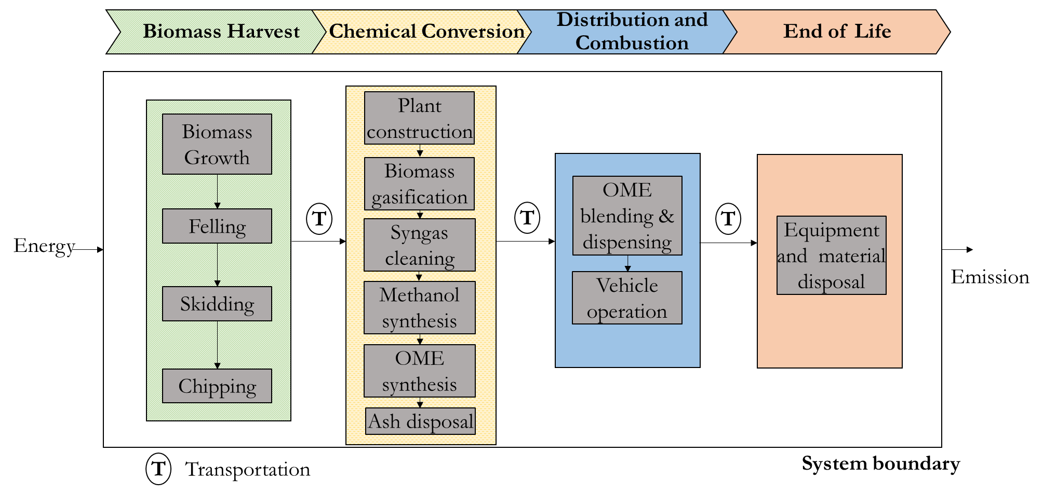
FUNNEL APPLICATION 3 BIOFUEL: SYSTEM BOUNDARY- OME FROM FOREST BIOMASS

Slide 48
FUNNEL APPLICATION 3 BIOFUEL: OXYMETHYLENE ETHER PATHWAYS
Oxymethylene ether pathways are:
  Whole Tree
  Forest Residues
Process modelling for oxymethylene ether conversion was developed in Aspen Plus and results integrated into FUNNEL
Information (data and empirical equations) from peer reviewed literature, Alberta specific assumptions, expert inputs and current practices

Slide 49
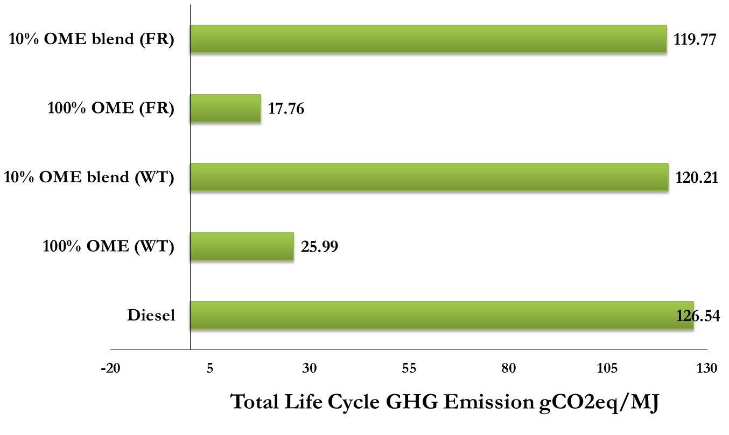
FUNNEL APPLICATION 3 BIOFUEL:
LIFE CYCLE GHG ASSESSMENT OF OME
Life Cycle GHG emissions of Oxymethylene ether from whole tree pathway was 25.99 gCO₂eq/MJ whereas forest residue pathway was 17.76 gCO₂eq/MJ
10% Oxymethylene ether blended with diesel reduced GHG emissions by 20-21% compared to 100% diesel
10% Oxymethylene ether blended with diesel reduced soot emissions by 30%
WT= Whole Tree; FR= Forest Residue

Slide 50
FUNNEL
RELATED PUBLICATIONS

Slide 51
FUNNEL RELATED PUBLICATIONS
Oil Sands
  Nimana, B.; Verma, A.; Di Lullo, G.; Rahman, M.M.; Canter, C.E.; Olateju, B.; Zhang, H.; Kumar, A. Life cycle analysis of bitumen transportation to refineries by rail and pipeline. Environ. Sci. Technol. [Online] 2017, 51, (1), pp 680-691 DOI: http://dx.doi.org/10.1021/acs.est.6b02889.
  Nimana, B.; Canter, C.; Kumar, A. Life cycle assessment of greenhouse gas emissions from Canada's oil sands-derived transportation fuels. Energy [Online] 2015, 88, pp 544-554 DOI: http://dx.doi.org/10.1016/j.energy.2015.05.078.
  Nimana, B.; Canter, C.; Kumar, A. Energy consumption and greenhouse gas emissions in upgrading and refining of Canada's oil sands products. Energy [Online] 2015, 83, pp 65-79 DOI: http://dx.doi.org/10.1016/j.energy.2015.01.085.
  Nimana, B.; Verma, A.; Di Lullo, G.; Rahman, M.M.; Canter, C.E.; Olateju, B.; Zhang, H.; Kumar, A. Life Cycle Analysis of Bitumen Transportation to Refineries by Rail and Pipeline. Environmental Science and Technology [Online] 2017, 51, (1), pp 680-691 DOI: http://doi.org/10.1021/acs.est.6b02889.

Slide 52
FUNNEL RELATED PUBLICATIONS
Future Oil Sands Technology
  Safaei, M.; Oni, A.O.; Gemechu, E.D.; Kumar, A. Evaluation of energy and greenhouse gas emissions of bitumen-derived transportation fuels from toe-to-heel air injection extraction technology. Fuel [Online] 2019, 256, p 115930 DOI: https://doi.org/10.1016/j.fuel.2019.115930.
  Safaei, M.; Oni, A.O.; Gemechu, E.D.; Kumar, A. Evaluation of energy and GHG emissions’ footprints of bitumen extraction using Enhanced Solvent Extraction Incorporating Electromagnetic Heating technology. Energy [Online] 2019, 186, p 115854 DOI: https://doi.org/10.1016/j.energy.2019.115854.
  Soiket, M.I.H.; Oni, A.O.; Kumar, A. The development of a process simulation model for energy consumption and greenhouse gas emissions of a vapor solvent-based oil sands extraction and recovery process. Energy [Online] 2019, 173, pp 799-808 DOI: https://doi.org/10.1016/j.energy.2019.02.109.
  Soiket, M.I.H.; Oni, A.O.; Gemechu, E.D.; Kumar, A. Life cycle assessment of greenhouse gas emissions of upgrading and refining bitumen from the solvent extraction process. Applied Energy [Online] 2019, 240, pp 236-250 DOI: https://doi.org/10.1016/j.apenergy.2019.02.039.

Slide 53
FUNNEL RELATED PUBLICATIONS
Conventional Crude Oils
  Rahman, M.M.; Canter, C.; Kumar, A. Well-to-wheel life cycle assessment of transportation fuels derived from different North American conventional crudes. Appl. Energy [Online] 2015, 156, pp 159-173 DOI: http://dx.doi.org/10.1016/j.apenergy.2015.07.004.
  Rahman, M.M.; Canter, C.; Kumar, A. Greenhouse gas emissions from recovery of various North American conventional crudes. Energy [Online] 2014, 74, pp 607-617 DOI: http://dx.doi.org/10.1016/j.energy.2014.07.026.

Slide 54
FUNNEL RELATED PUBLICATIONS
Uncertainty Analysis
  Di Lullo, G.; Zhang, H.; Kumar, A. Uncertainty in well-to-tank with combustion greenhouse gas emissions of transportation fuels derived from North American crudes. Energy [Online] 2017, 128, pp 475-486 DOI: http://doi.org/10.1016/j.energy.2017.04.040.
  Di Lullo, G.; Zhang, H.; Kumar, A. Evaluation of uncertainty in the well-to-tank and combustion greenhouse gas emissions of various transportation fuels. Appl. Energy [Online] 2016, 184, pp 413-426 DOI: http://doi.org/10.1016/j.apenergy.2016.10.027.
  Di Lullo, G.; Gemechu, E.; Oni, A.O.; Kumar, A. Extending sensitivity analysis using regression to effectively disseminate life cycle assessment results. The International Journal of Life Cycle Assessment [Online] 2019, DOI: http://doi.org/10.1007/s11367-019-01674-y.

Slide 55
FUNNEL RELATED PUBLICATIONS
Natural Gas
  Raj, R.; Ghandehariun, S.; Kumar, A.; Linwei, M. A well-to-wire life cycle assessment of Canadian shale gas for electricity generation in China. Energy [Online] 2016, 111, pp 642-652 DOI: https://doi.org/10.1016/j.energy.2016.05.079.
  Sapkota, K.; Oni, A.O.; Kumar, A. Techno-economic and life cycle assessments of the natural gas supply chain from production sites in Canada to north and southwest Europe. J. Nat. Gas Sci. Eng. [Online] 2018, DOI: https://doi.org/10.1016/j.jngse.2018.01.048.

Slide 56
FUNNEL RELATED PUBLICATIONS
Biofuel
  Mahbub, N.; Gemechu, E.; Zhang, H.; Kumar, A. The life cycle greenhouse gas emission benefits from alternative uses of biofuel coproducts. Sustainable Energy Technologies and Assessments [Online] 2019, 34, pp 173-186 DOI: https://doi.org/10.1016/j.seta.2019.05.001.
  Mahbub, N.; Oyedun, A.O.; Zhang, H.; Kumar, A.; Poganietz, W.-R. A life cycle sustainability assessment (LCSA) of oxymethylene ether as a diesel additive produced from forest biomass. The International Journal of Life Cycle Assessment [Online] 2019, 24, (5), pp 881-899 DOI: 10.1007/s11367-018-1529-6.
  Mahbub, N.; Oyedun, A.O.; Kumar, A.; Oestreich, D.; Arnold, U.; Sauer, J. A life cycle assessment of oxymethylene ether synthesis from biomass-derived syngas as a diesel additive. Journal of Cleaner Production [Online] 2017, 165, pp 1249-1262 DOI: 10.1016/j.jclepro.2017.07.178.
  Miller, P.; Kumar, A. Development of emission parameters and net energy ratio for renewable diesel from Canola and Camelina. Energy [Online] 2013, 58, pp 426-437.
  Wong, A.; Zhang, H.; Kumar, A. Life cycle assessment of renewable diesel production from lignocellulosic biomass. The International Journal of Life Cycle Assessment [Online] 2016, 21, (10), pp 1404-1424.
  Oyedun, A.O.; Patel, M.; Kumar, M.; Kumar, A. Upgrading of bio-oil via hydrodeoxygenation. In Chemical Catalysts for Biomass Upgrading; Brown, R., Ed. Wiley-VCH: in press.

Slide 57
FUNNEL RELATED PUBLICATIONS
Hydrogen
  Ghandehariun, S.; Kumar, A. Life cycle assessment of wind-based hydrogen production in Western Canada. International Journal of Hydrogen Energy [Online] 2016, 41, (22), pp 9696-9704 DOI: https://doi.org/10.1016/j.ijhydene.2016.04.077.
  Olateju, B.; Monds, J.; Kumar, A. Large scale hydrogen production from wind energy for the upgrading of bitumen from oil sands. Applied Energy [Online] 2014, 118, pp 48-56 DOI: https://doi.org/10.1016/j.apenergy.2013.12.013.
  Sarkar, S.; Kumar, A. Large-scale biohydrogen production from bio-oil. Bioresource technology [Online] 2010, 101, (19), pp 7350-7361.
  Kumar, M.; Oni, A.O.; Kumar, A. Biohydrogen production from bio-oil via hydrothermal liquefaction. In Biofuels; Elsevier Inc.: Amsterdam, The Netherlands, in press.
  Kumar, M.; Oyedun, A.O.; Kumar, A. A comparative analysis of hydrogen production from the thermochemical conversion of algal biomass. International Journal of Hydrogen Energy [Online] 2019, 44, (21), pp 10384-10397 DOI: https://doi.org/10.1016/j.ijhydene.2019.02.220.

Slide 58
FUNNEL RELATED PUBLICATIONS
Storage
  Thaker, S.; Oni, A.O.; Gemechu, E.; Kumar, A. Evaluating energy and greenhouse gas emission footprints of thermal energy storage systems for concentrated solar power applications. Journal of Energy Storage [Online] 2019, 26, p 100992 DOI: https://doi.org/10.1016/j.est.2019.100992.
  Kapila, S.; Oni, A.O.; Gemechu, E.D.; Kumar, A. Development of net energy ratios and life cycle greenhouse gas emissions of large-scale mechanical energy storage systems. Energy [Online] 2019, 170, pp 592-603 DOI: https://doi.org/10.1016/j.energy.2018.12.183.

Slide 59
FUNNEL RELATED PUBLICATIONS
Biomass / Pellets for Heat / Electricity
  Thakur, A.; Canter, C.E.; Kumar, A. Life-cycle energy and emission analysis of power generation from forest biomass. Applied Energy [Online] 2014, 128, pp 246-253.
  Kabir, M.R.; Kumar, A. Comparison of the energy and environmental performances of nine biomass/coal co-firing pathways. Bioresource technology [Online] 2012, 124, pp 394-405.
  Sultana, A.; Kumar, A. Development of energy and emission parameters for densified form of lignocellulosic biomass. Energy [Online] 2011, 36, (5), pp 2716-2732.
  Shahrukh, H.; Oyedun, A.O.; Kumar, A.; Ghiasi, B.; Kumar, L.; Sokhansanj, S. Net energy ratio for the production of steam pretreated biomass-based pellets. Biomass and Bioenergy [Online] 2015, 80, (0), pp 286-297 DOI: http://dx.doi.org/10.1016/j.biombioe.2015.06.006.
  Shahrukh, H.; Oyedun, A.O.; Kumar, A.; Ghiasi, B.; Kumar, L.; Sokhansanj, S. Comparative net energy ratio analysis of pellet produced from steam pretreated biomass from agricultural residues and energy crops. Biomass and Bioenergy [Online] 2016, 90, pp 50-59 DOI: doi:10.1016/j.biombioe.2016.03.022.
Other Publications and Presentations
  http://www.ualbertaenergysystems.ca/

Slide 60
ACKNOWLEDGMENTS
Thanks to the NSERC/Cenovus/Alberta Innovates Associate Industrial Research Chair in Energy and Environmental Systems Engineering and the Cenovus Energy Endowed Chair in Environmental Engineering for providing financial support.
We are also grateful to representatives from Cenovus Energy Inc., Alberta Innovates, Suncor Energy Inc., Environment and Climate Change Canada, Natural Resources Canada, and Alberta Department of Energy for their valuable inputs and comments in various forms.
As a part of the University of Alberta's Future Energy Systems (FES) research initiative, this research was made possible in part thanks to funding from the Canada First Research Excellence Fund (CFREF).

Slide 61
THANK YOU / QUESTIONS
  For further information:
Website: www.energysystem.ualberta.ca
Amit Kumar, Prof.
NSERC/Cenovus/Alberta Innovates Associate Industrial Research Chair in Energy and Environmental Systems Engineering
Cenovus Energy Endowed Chair in Environmental Engineering
Deputy Director: Future Energy Systems
Department of mechanical engineering, University of Alberta.
E-mail: Amit.Kumar@ualberta.ca

